Slide 1
UPDATE ON UTAH LAKE C, N, AND P PROJECT
Contributors

Slide 2
COMPONENTS
Quantification of conceptual model
External mass balance
SedFlux modeling

Slide 3
EXTERNAL MASS BALANCE

Slide 4
Constituent | Method and Reporting Limit UDWQ | Method and Reporting Limit WFWQC
TP | EPA-NERL: 365.1: (4823) Phosphorus (all forms) by Semi-Automated Colorimetry 0.02 | Hach Co.: 8048: Orthophosphate by Colorimetry 0.021
TDP | EPA-NERL: 365.1: (4823) Phosphorus (all forms) by Semi-Automated Colorimetry 0.02 | Hach Co.: 8048: Orthophosphate by Colorimetry 0.021
TN | APHA 4500-N Persulfate Method for Total Nitrogen 0.2 | Hach Co.: 10242: (TNTplus 880) Simplified Spectrophotometric Measurement of TKN in Water and Wastewater 0.7
TDN | APHA 4500-N Persulfate Method for Total Nitrogen 0.2
TOC | APHA 5310 B Total Organic Carbon by Combustion-Infrared Method 0.5
DOC | APHA 5310 B Total Organic Carbon by Combustion-Infrared Method 0.5
Lowercase text

Slide 5
WATERSHEDS
Watersheds w/o WWTP, monitored by only UDWQ | Watersheds w/o WWTP, monitored by both UDWQ and WFWQC | Watersheds with WWTP
Tickville Wash | Lehi Spring Creek | Timp SSD (Timpanogos)
Dry Creek – Saratoga | American Fork River | Powell Slough Major (Orem)
Dry Creek – Spanish Fork | Lindon Drain | Mill Race (Provo)
Currant Creek | Provo River | Spring Creek – Springville (Springville)
 | Hobble Creek | Dry Creek – Spanish Fork (Spanish Fork)
 | Spanish Fork River | Benjamin Slough (Payson, Salem)
 | 4000 South Drain Spanish Fork
Use values directly
Compare entities, use values from one or both
Compare entities + address potential for attenuation of WWTP loading

Slide 6
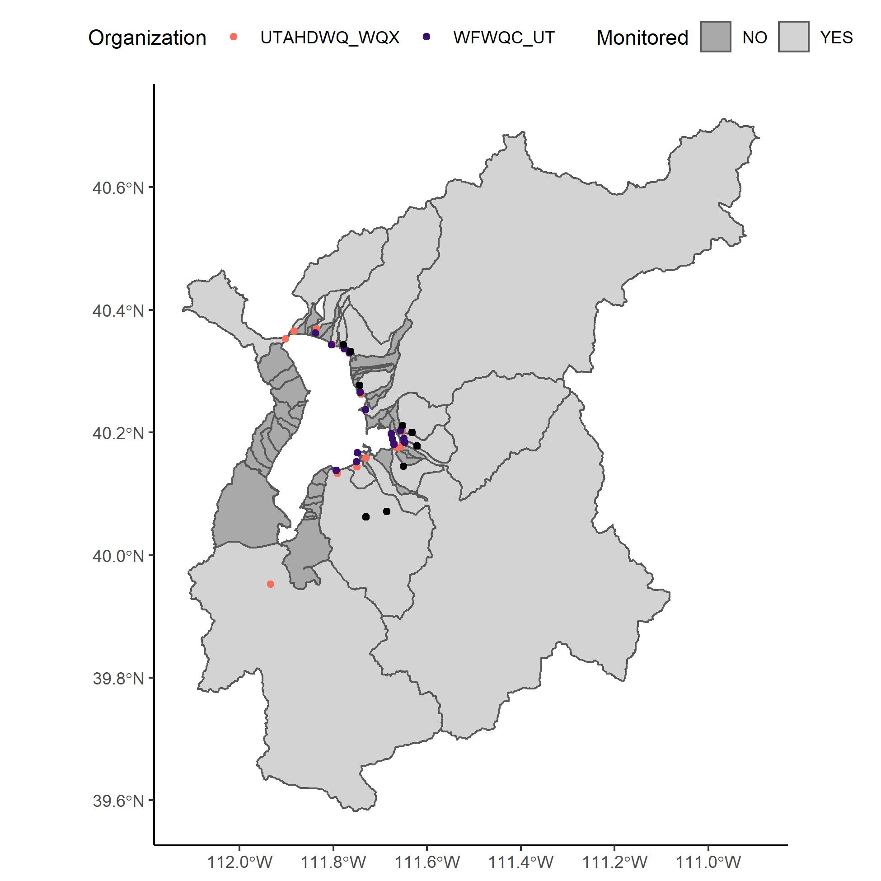
WATERSHEDS
UDWQ sites: orange
WFWQC sites: purple
Facility sites: black
Majority of watershed is monitored
Focus on these today
Unmonitored sites upcoming (paired watershed approach)

Slide 7
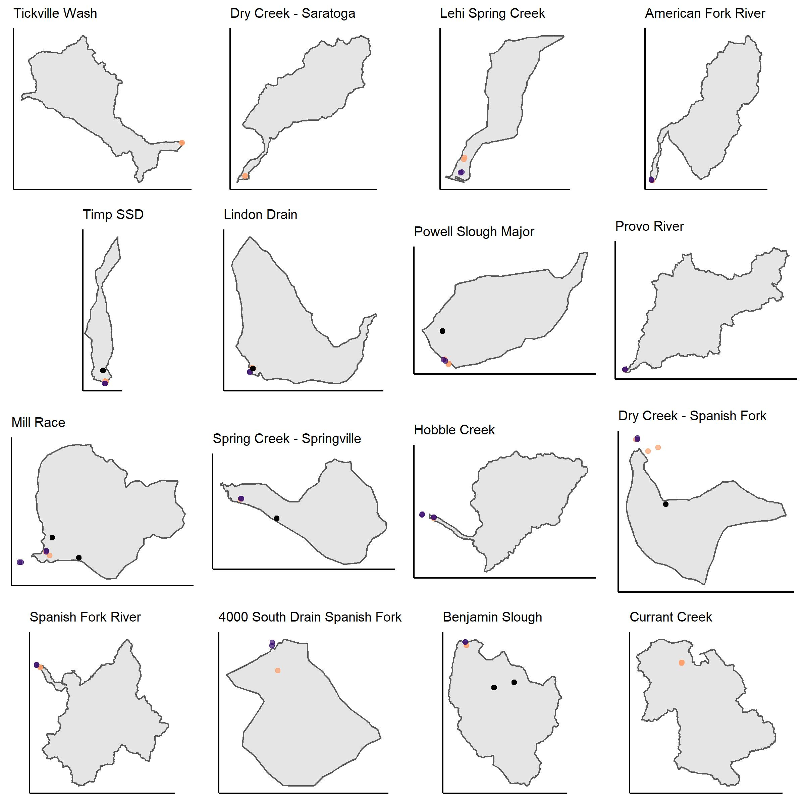
WATERSHEDS (NOT TO SCALE)
UDWQ sites: orange
WFWQC sites: purple
Facility sites: black
WFWQC sites are downstream or at the same location as UDWQ sites
Some sites are below the compromise elevation

Slide 8
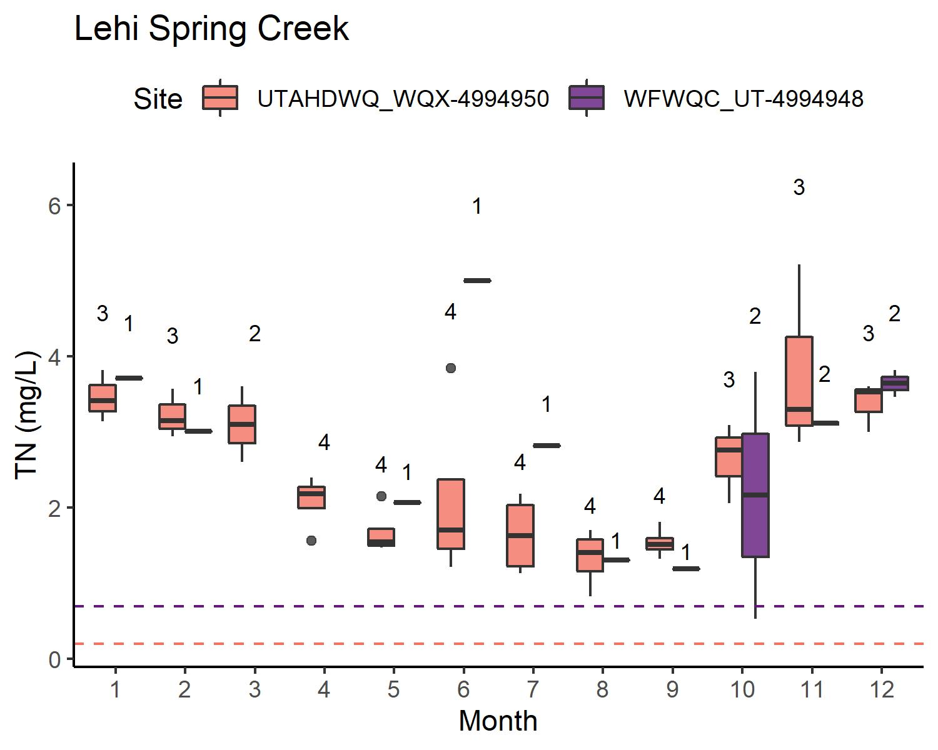
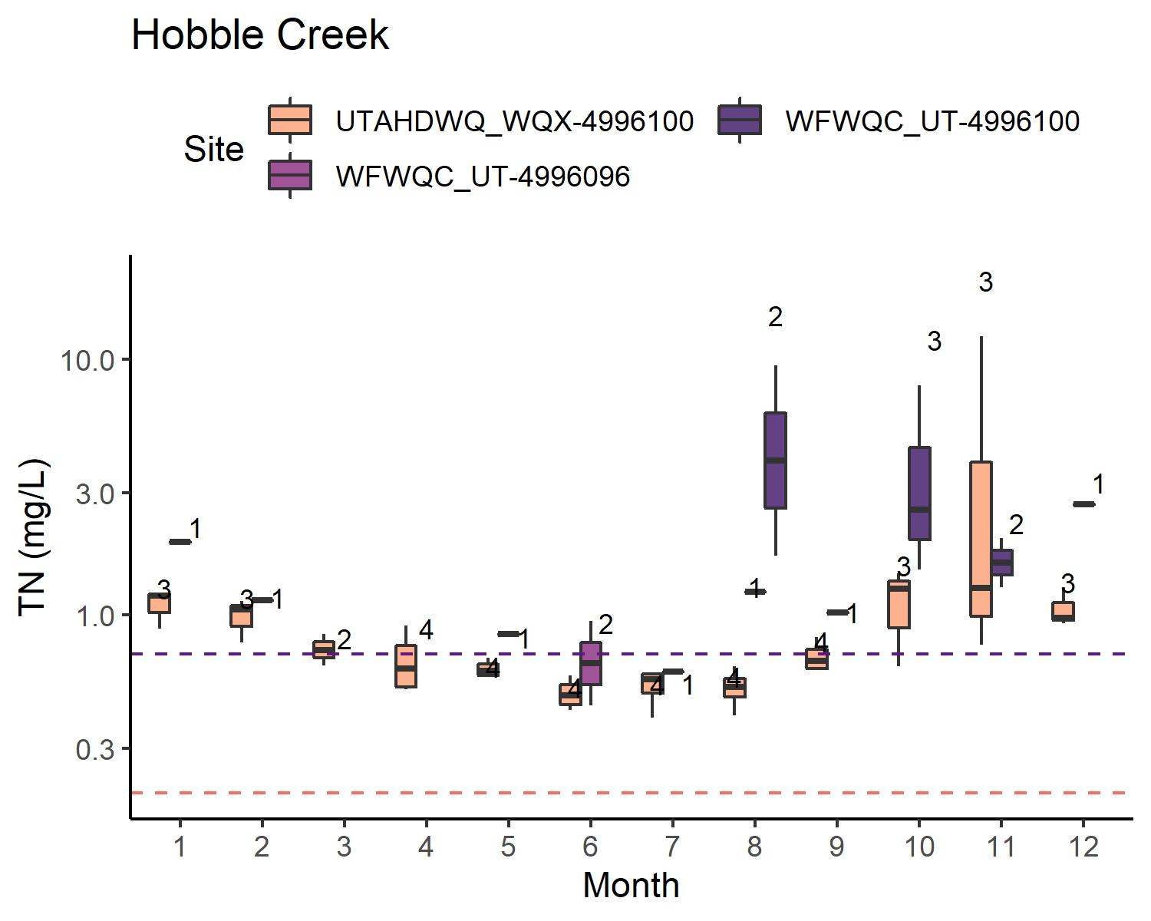
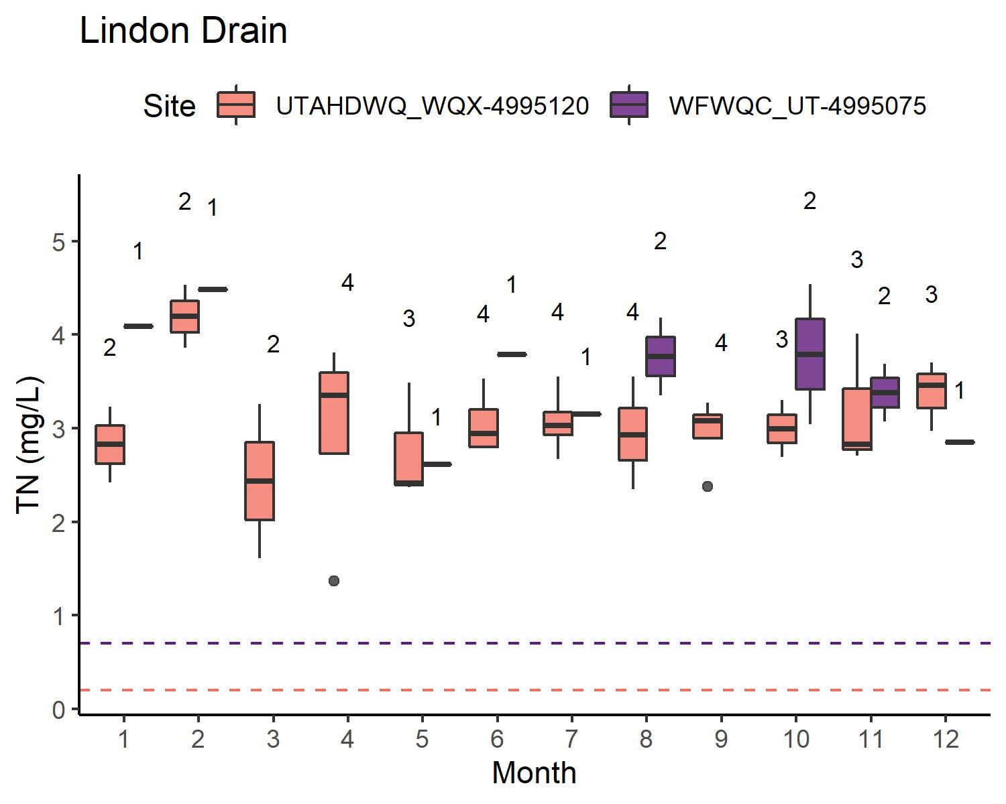
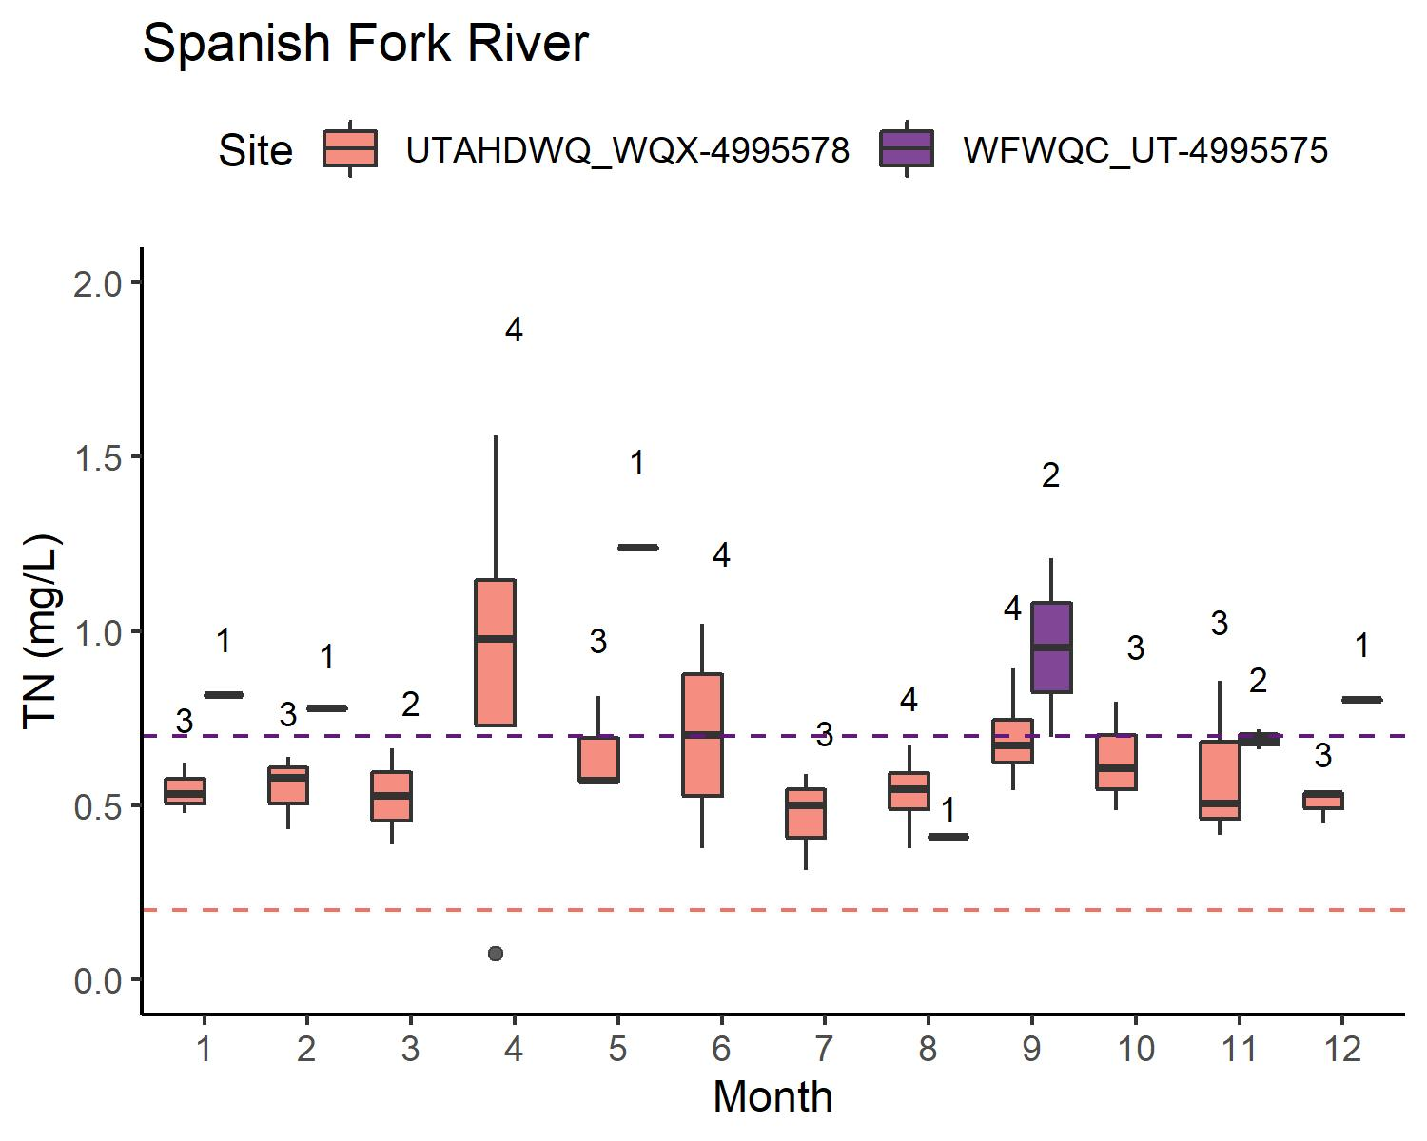
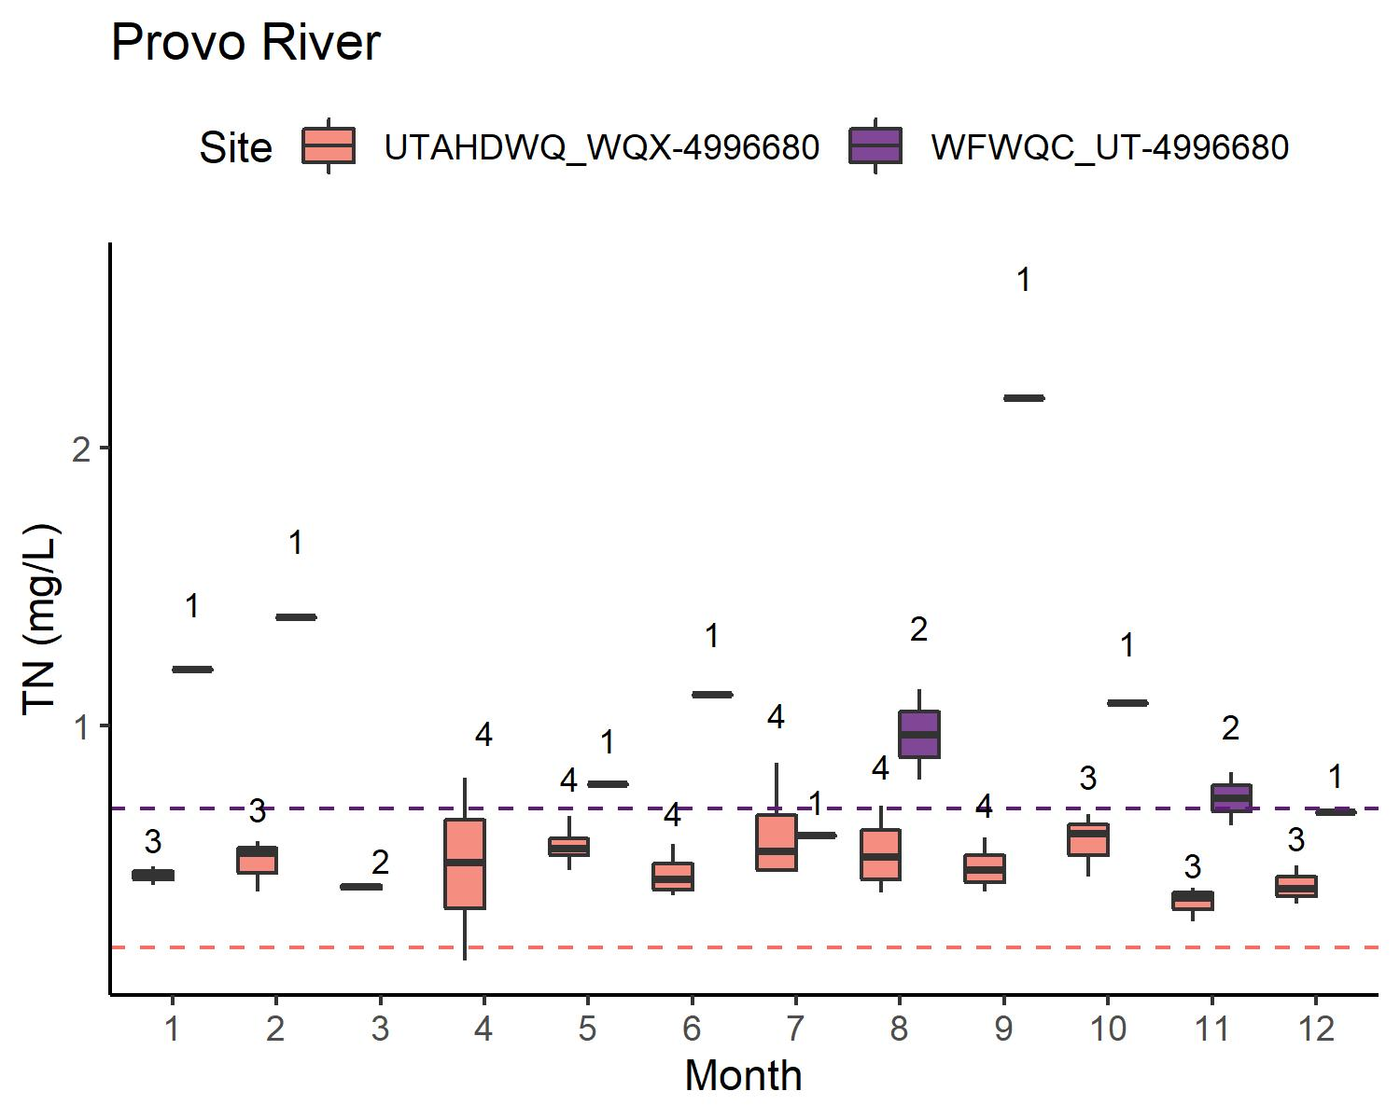
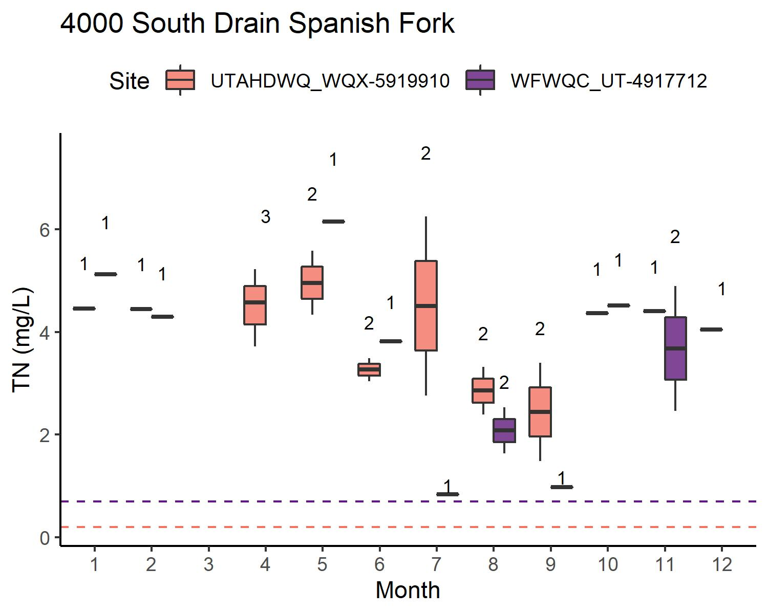
TN: WATERSHEDS W/O WWTP
Concentrations: typically equivalent or UDWQ < WFWQC
UDWQ generally has a more comprehensive sampling schedule than WFWQC
TN < WFWQC reporting limit for
Provo River
Hobble Creek
Spanish Fork River
(American Fork River is intermittent, not shown)

Slide 9
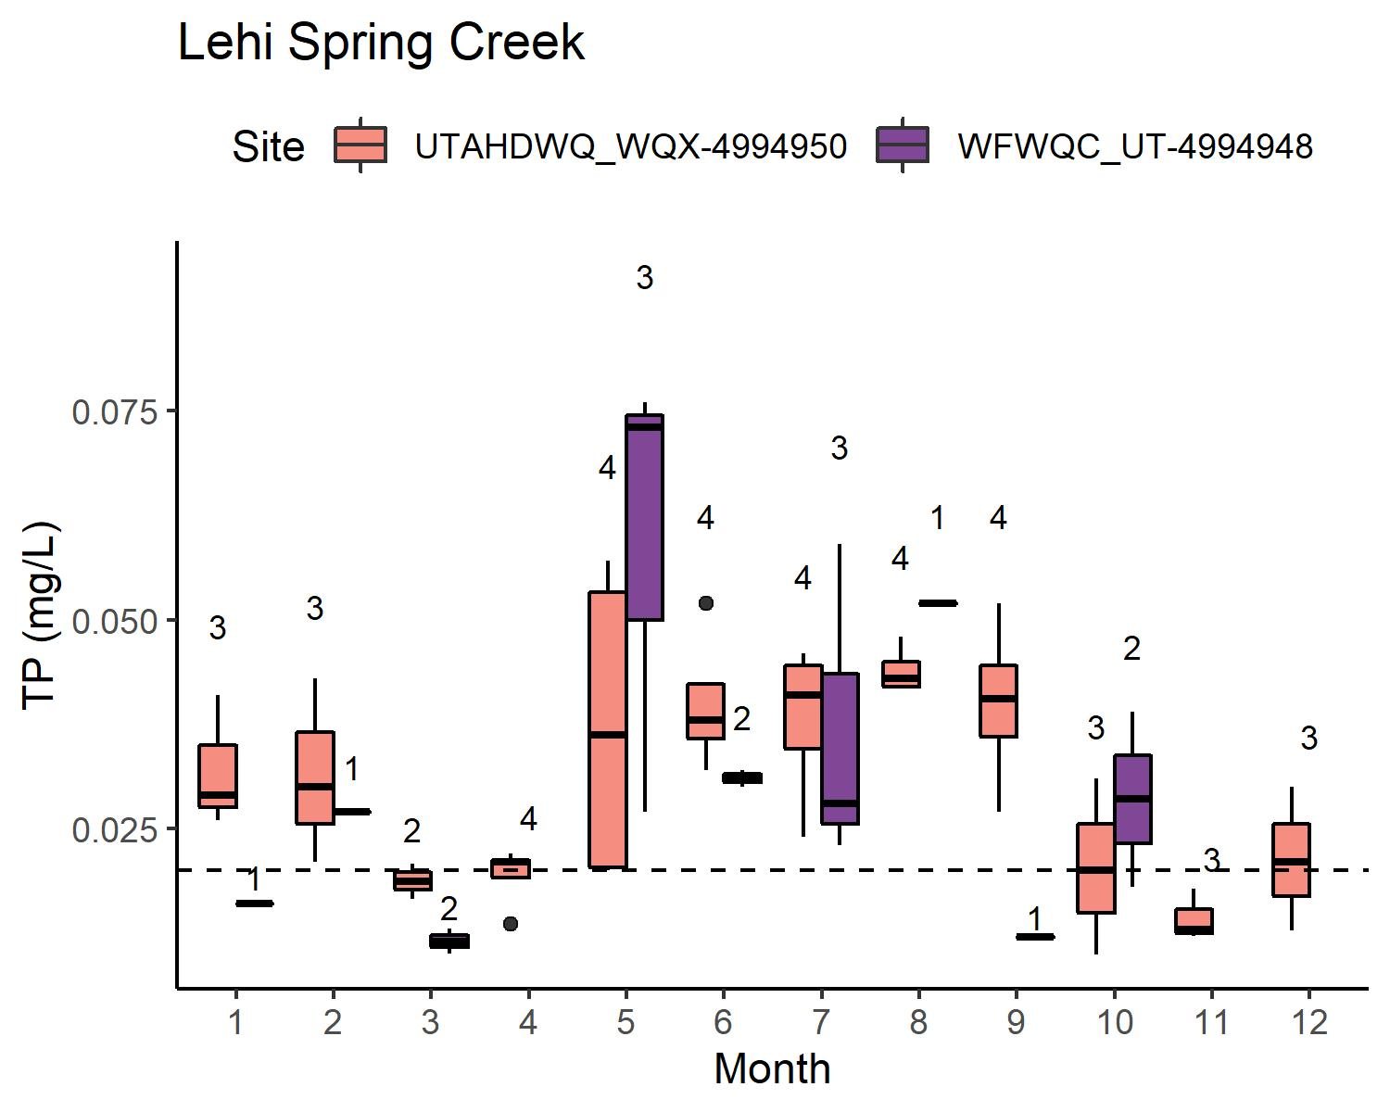
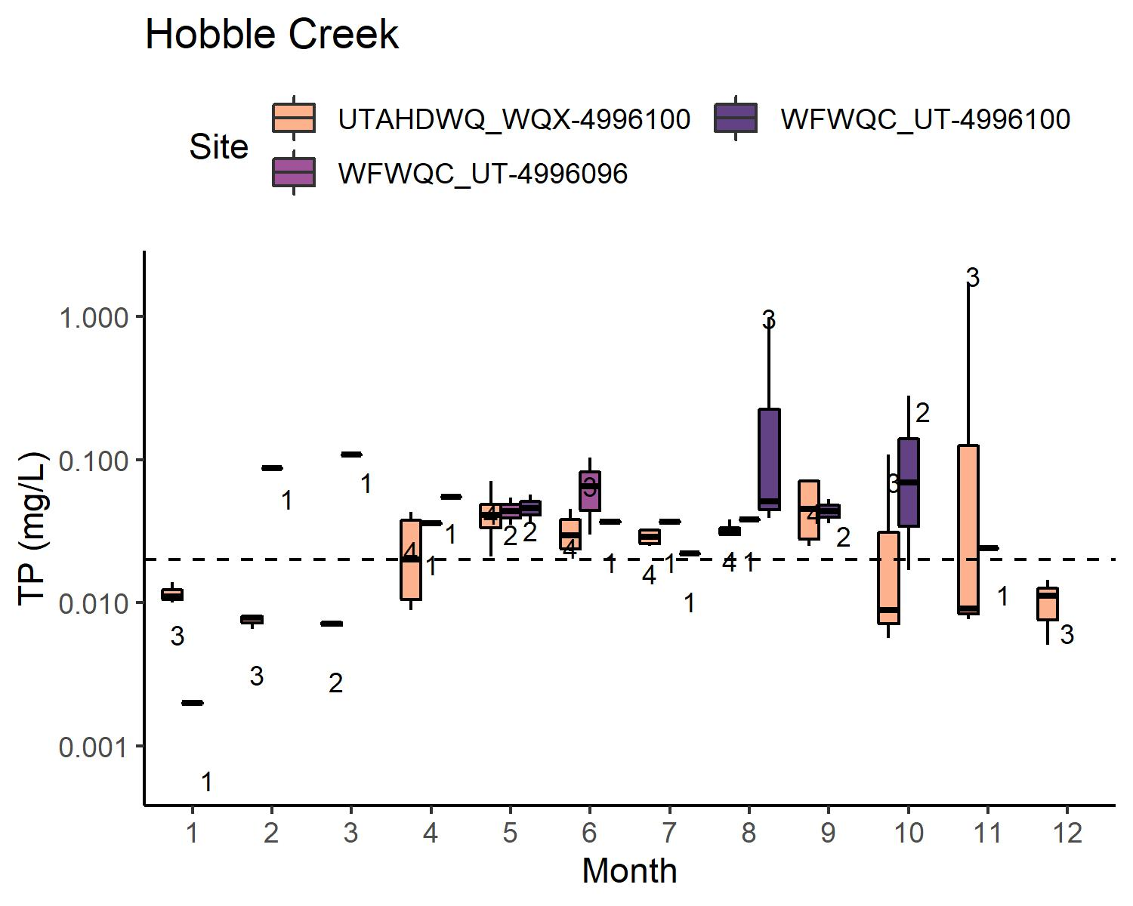
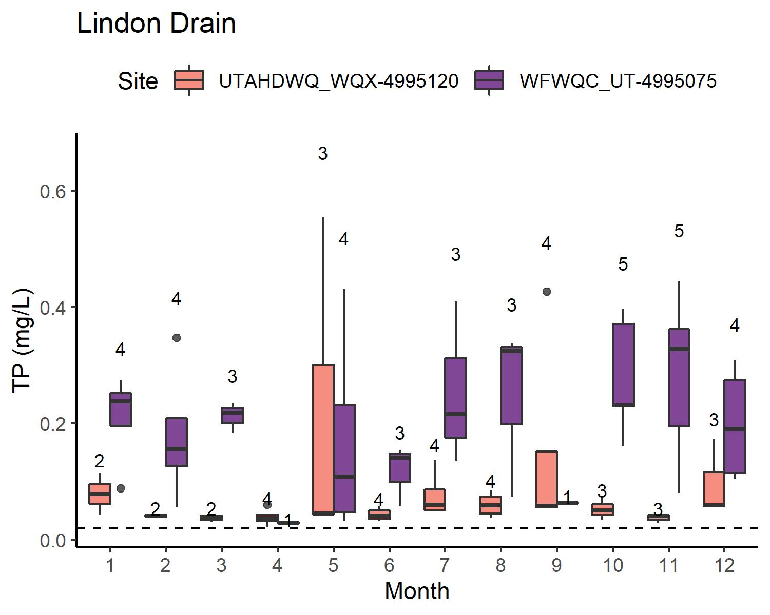
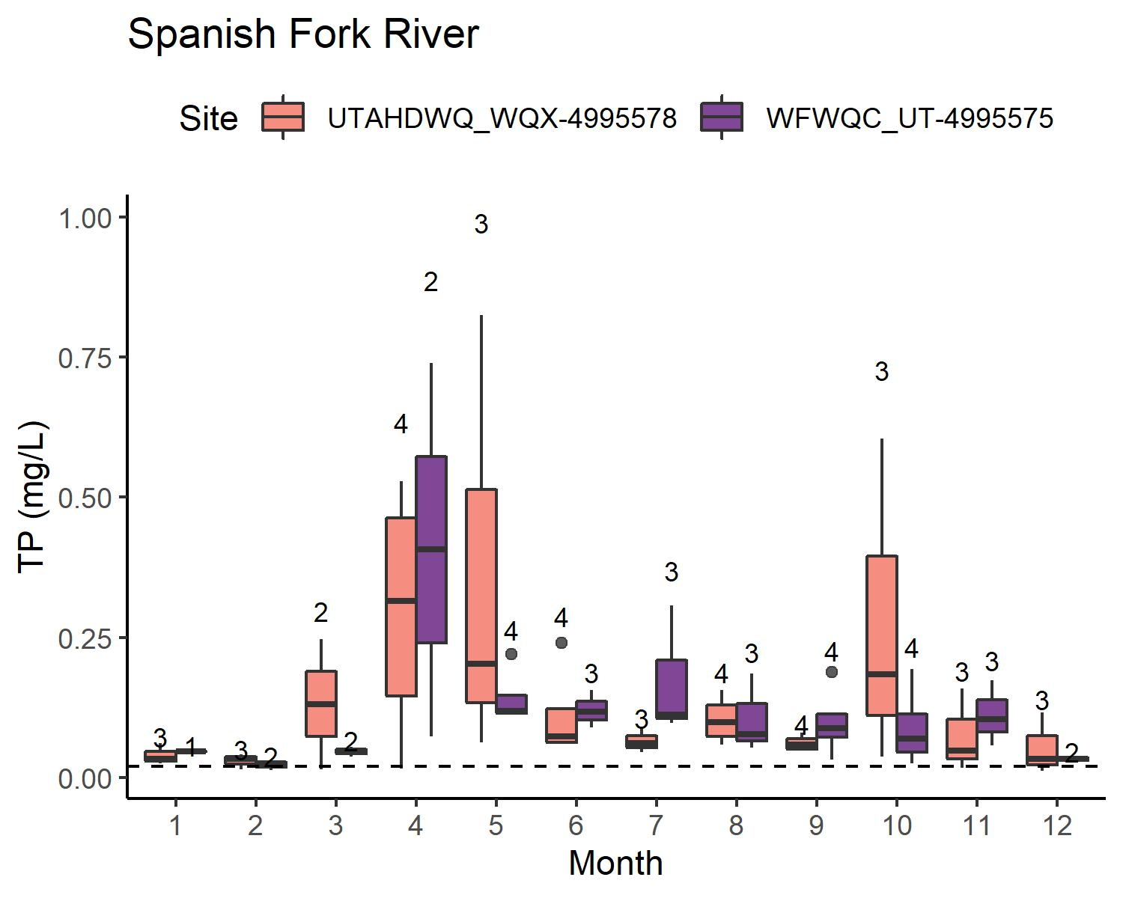
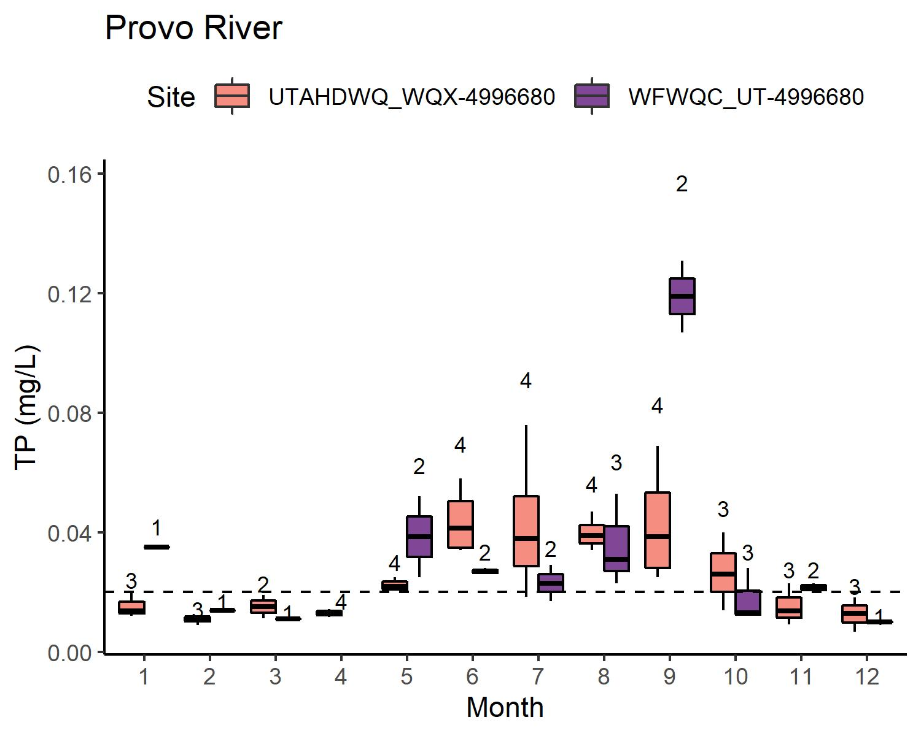
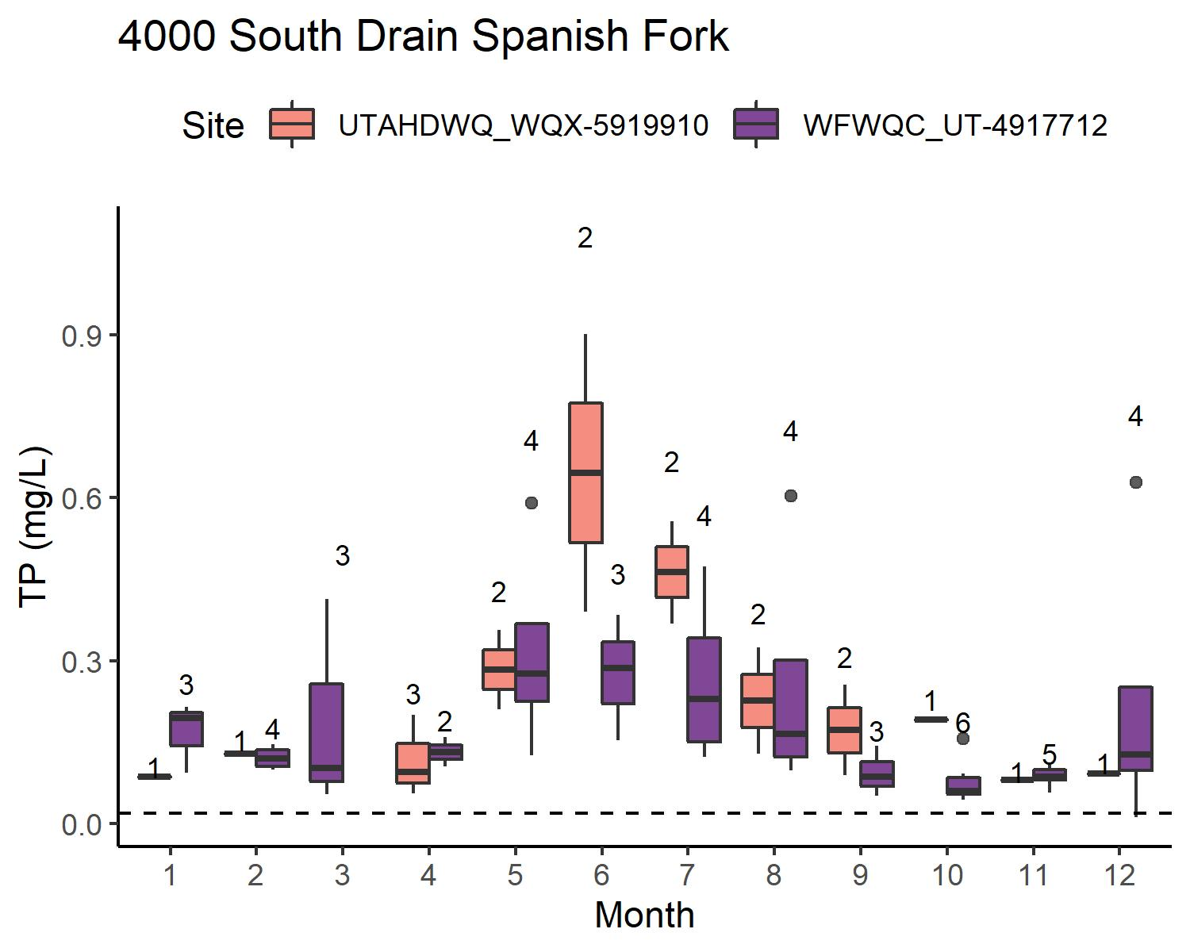
TP: WATERSHEDS W/O WWTP
Concentrations: typically equivalent or UDWQ < WFWQC
UDWQ generally has a more comprehensive sampling schedule than WFWQC
TP sometimes < reporting limit for
Provo River
Hobble Creek
(American Fork River is intermittent, not shown)

Slide 10
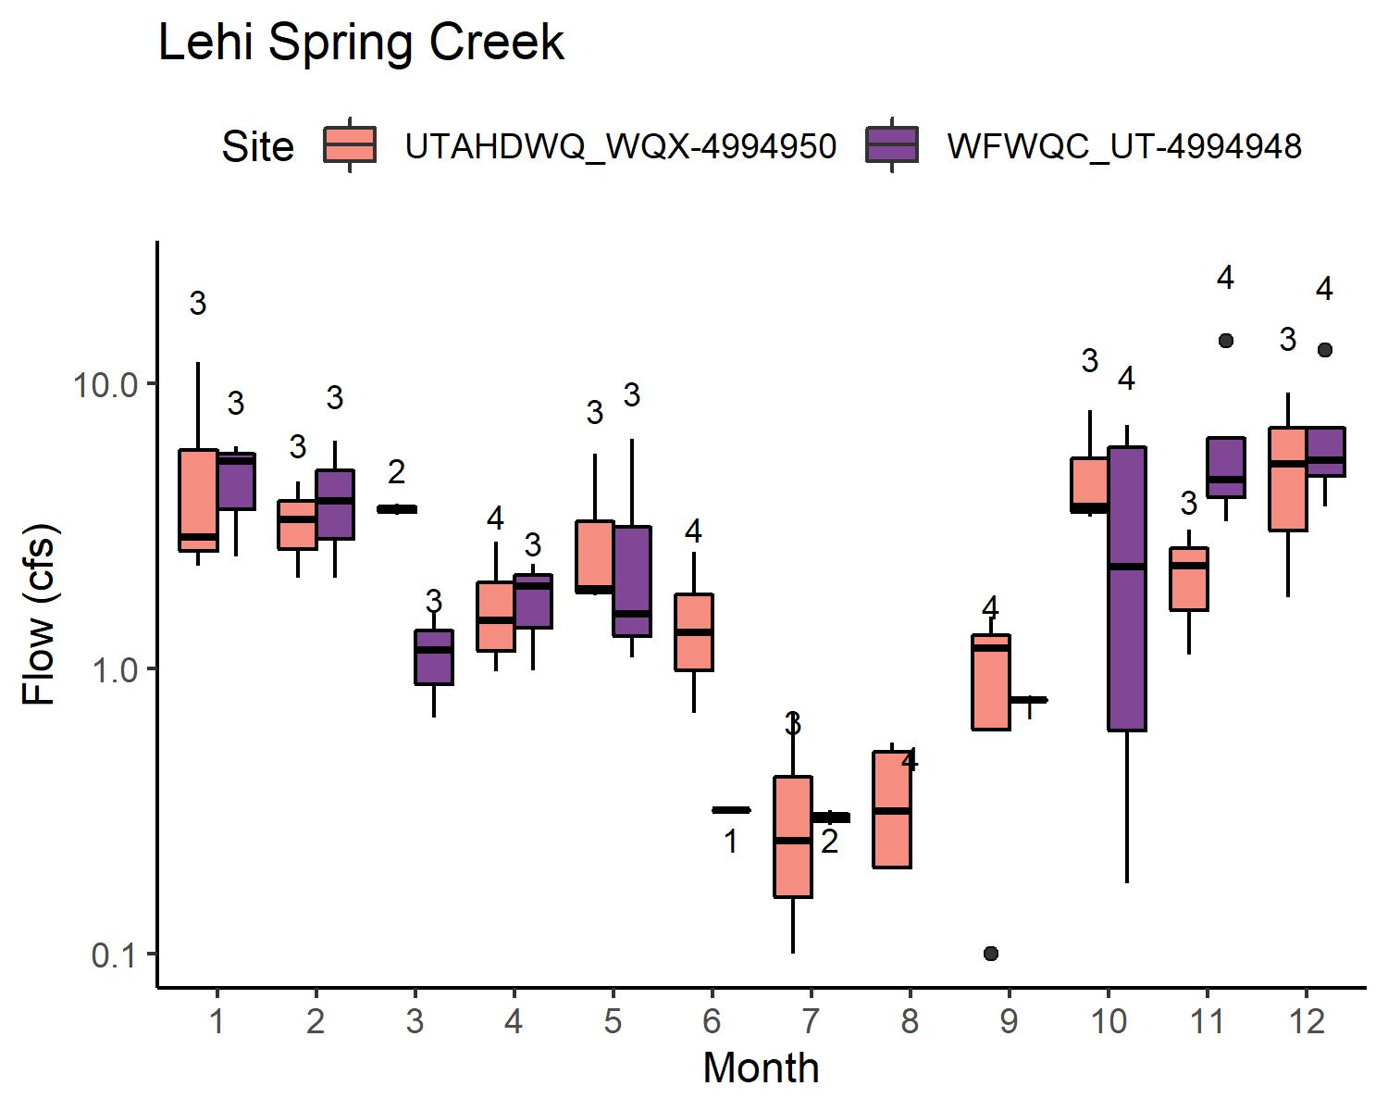
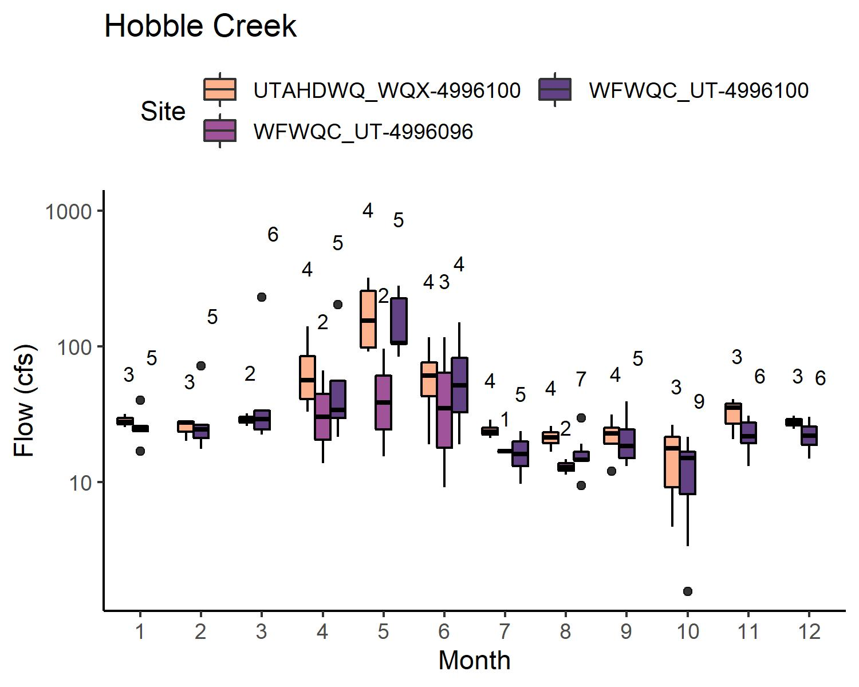
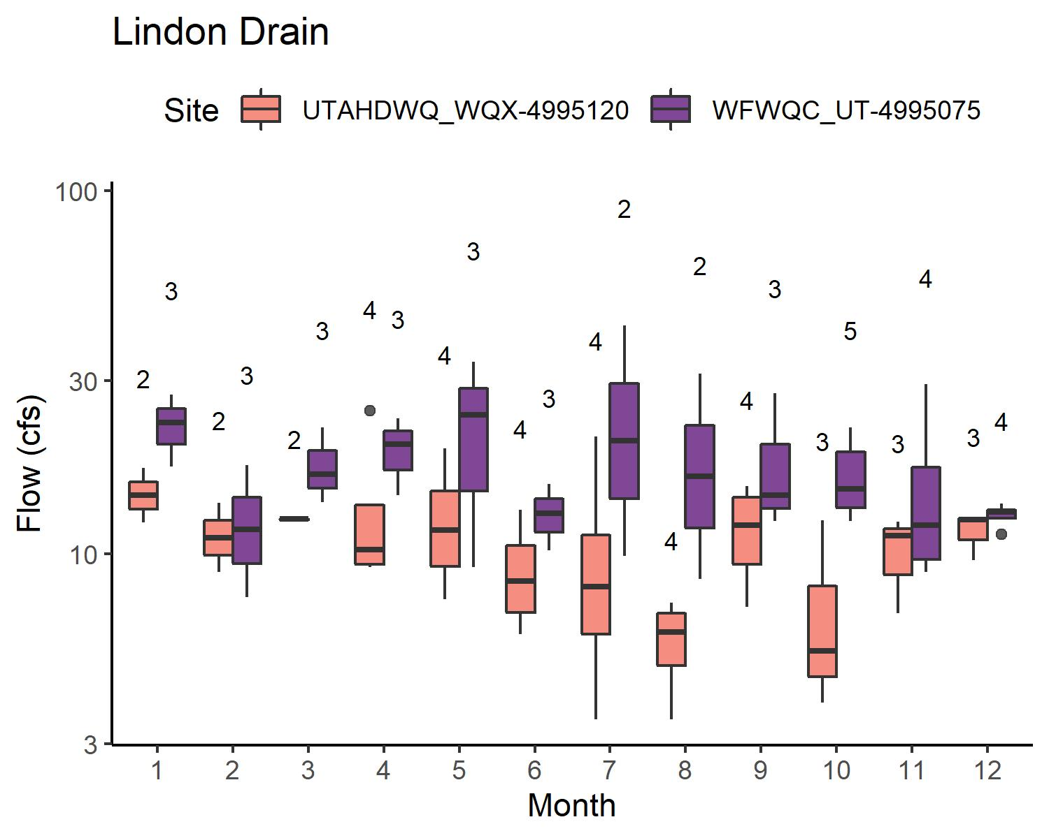
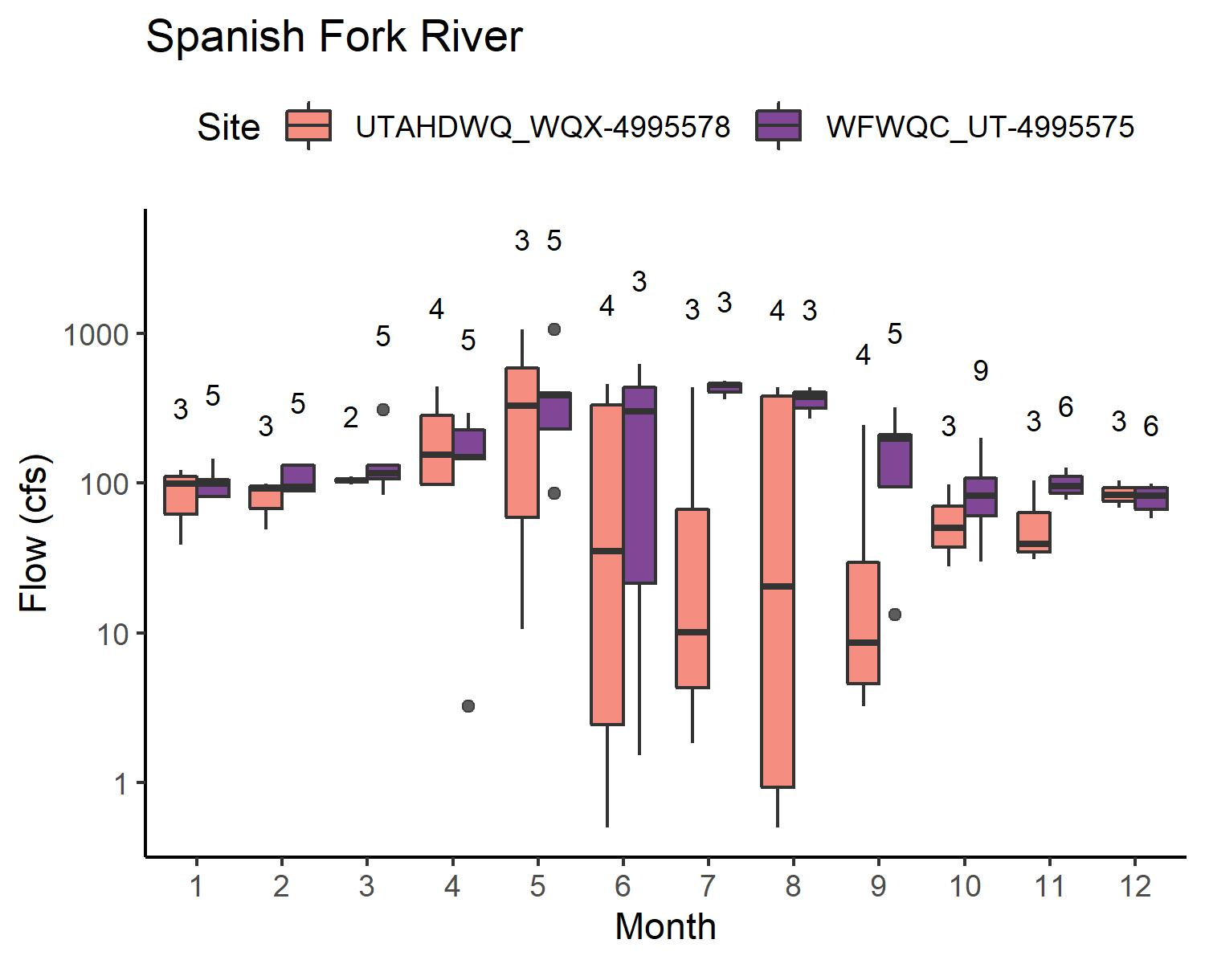
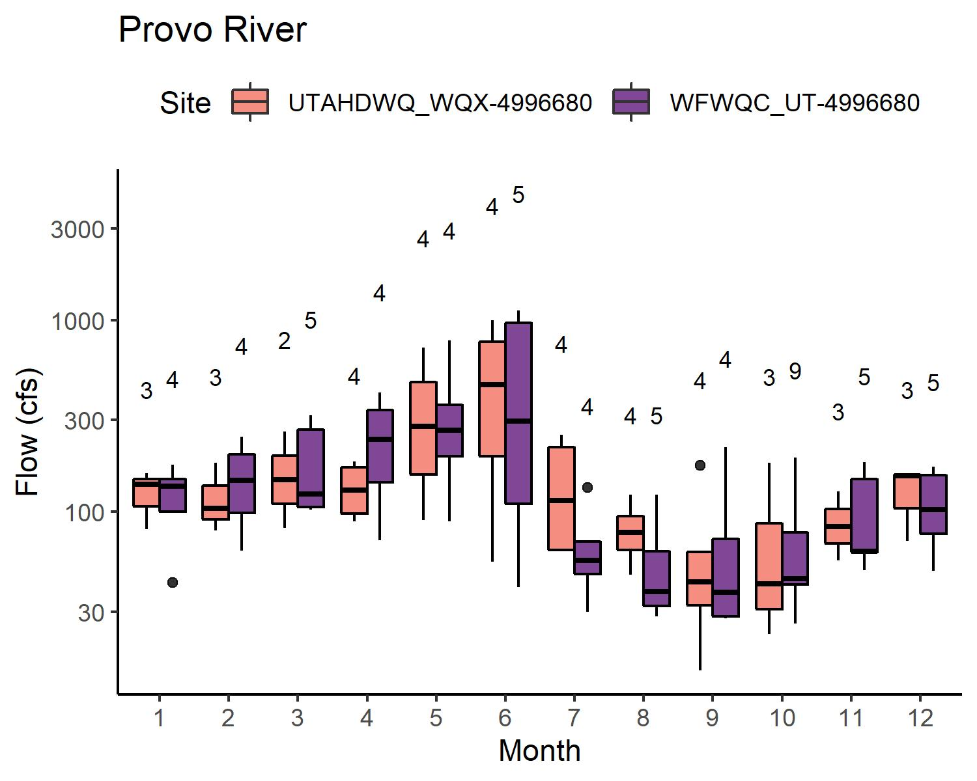
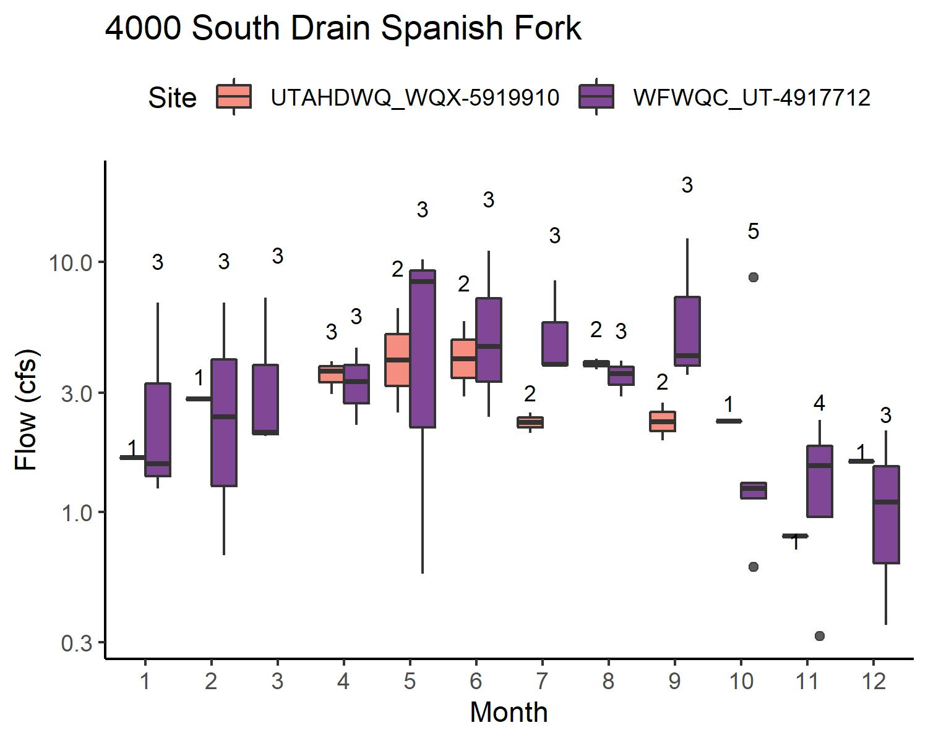
FLOW: WATERSHEDS W/O WWTP
Flow: UDWQ ≈ WFWQC
Lehi Spring Creek
American Fork River (variable, intermittent, not pictured)
Provo River
Hobble Creek
4000 South Drain Spanish Fork
Flow: UDWQ < WFWQC
Lindon Drain
Spanish Fork River

Slide 11
WATERSHEDS W/ WWTP
Higher concentrations of nutrients → reporting limit likely not an issue
In some cases, multiple sites represent total load → direct comparison for UDWQ vs. WFWQC not as clear

Slide 12
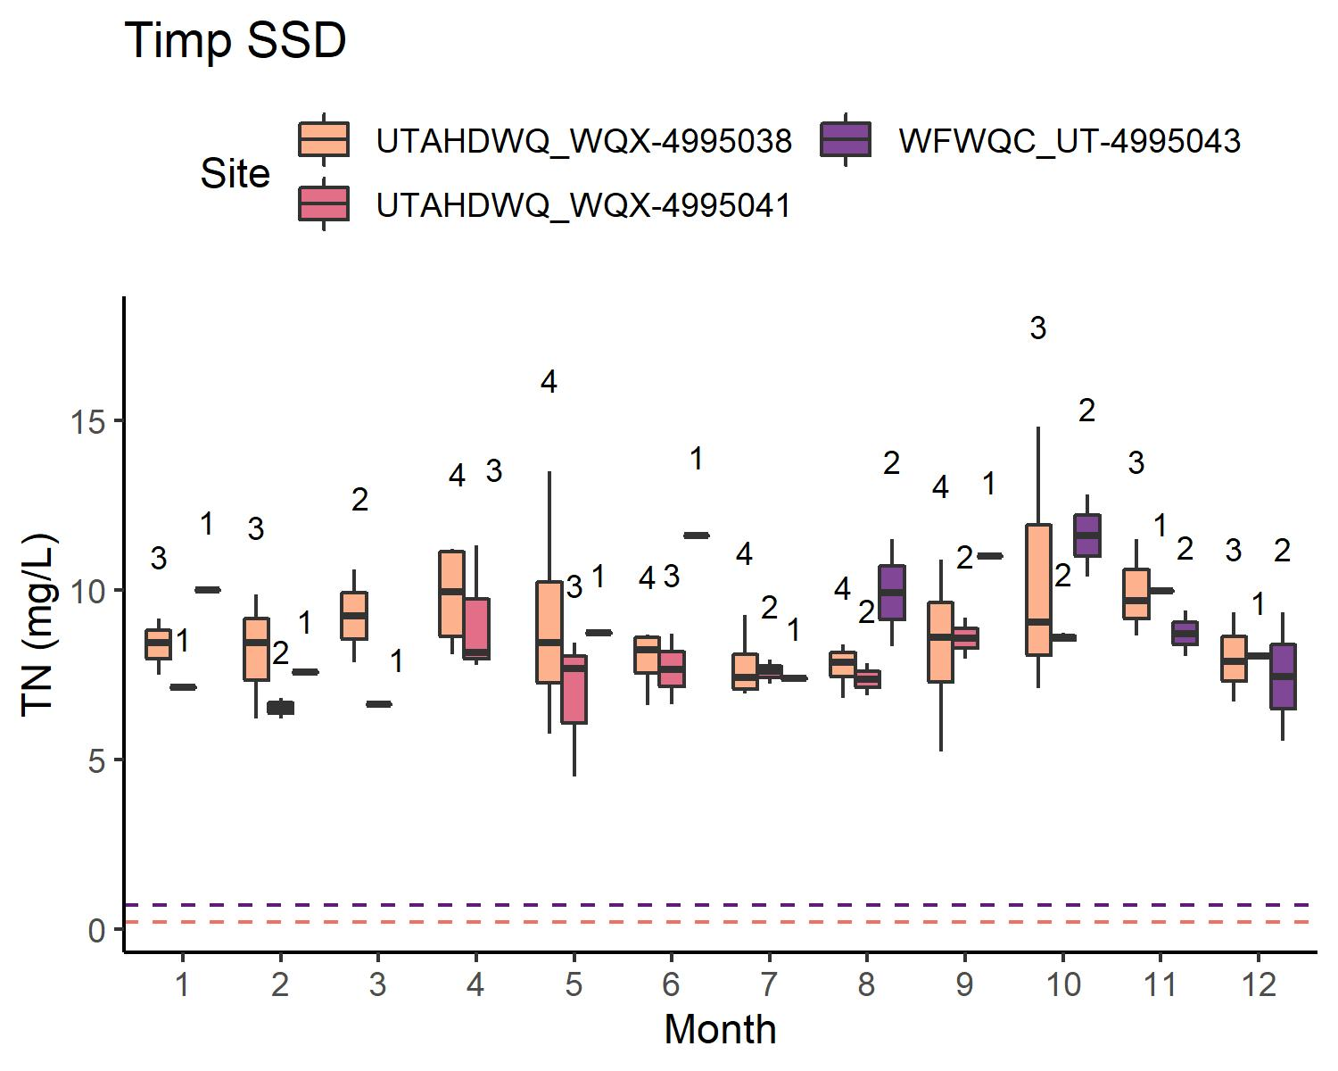
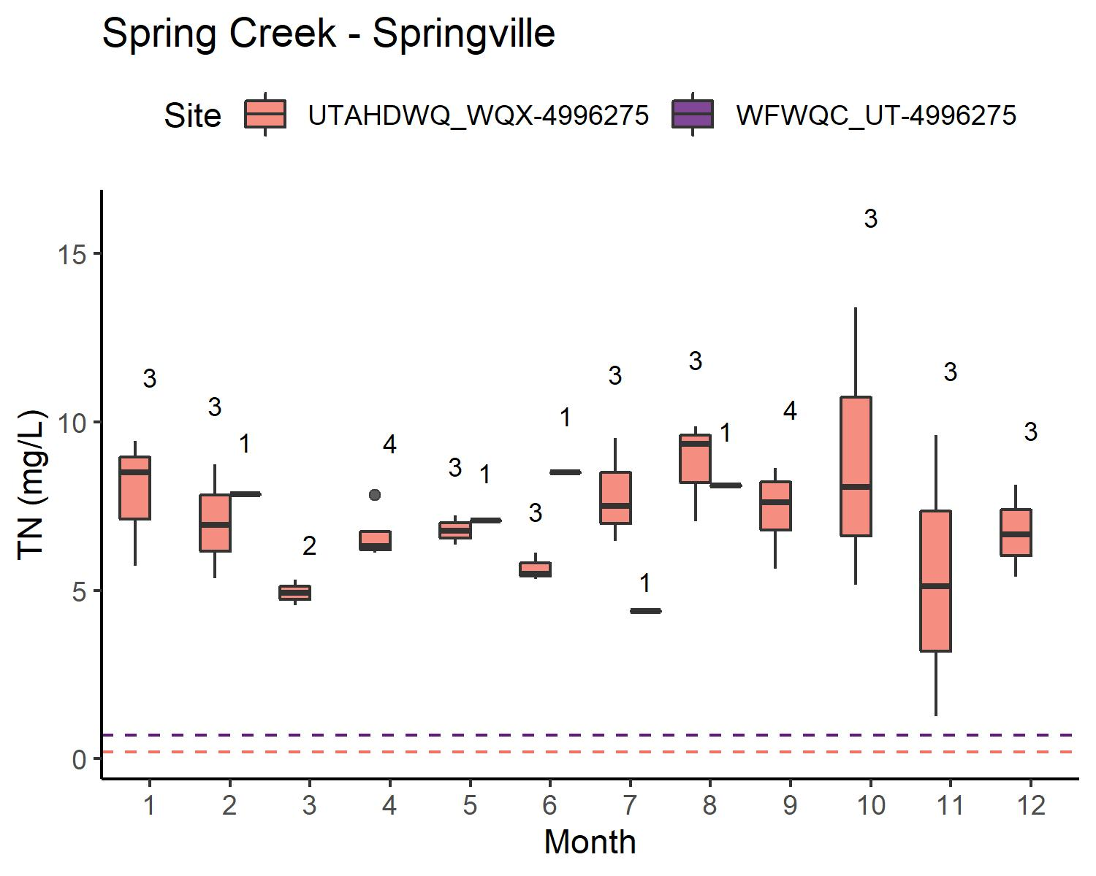
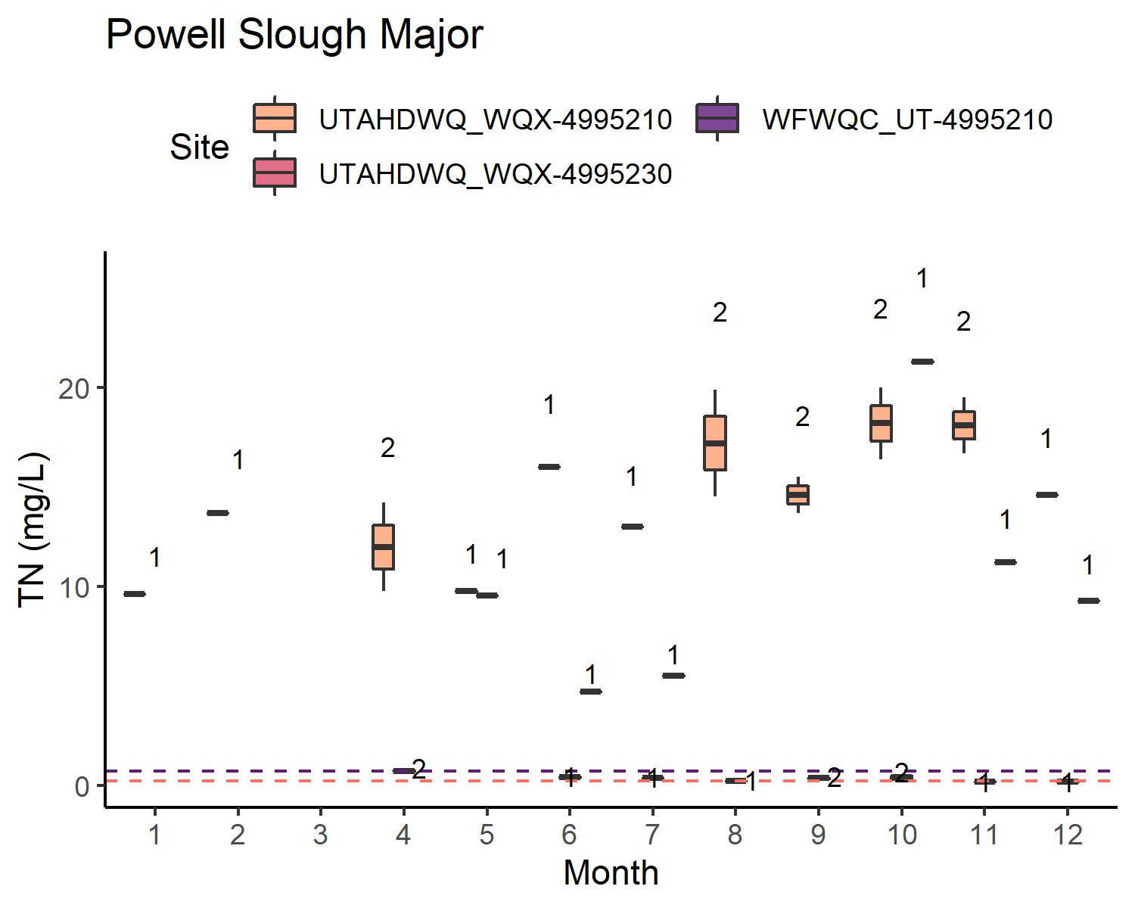
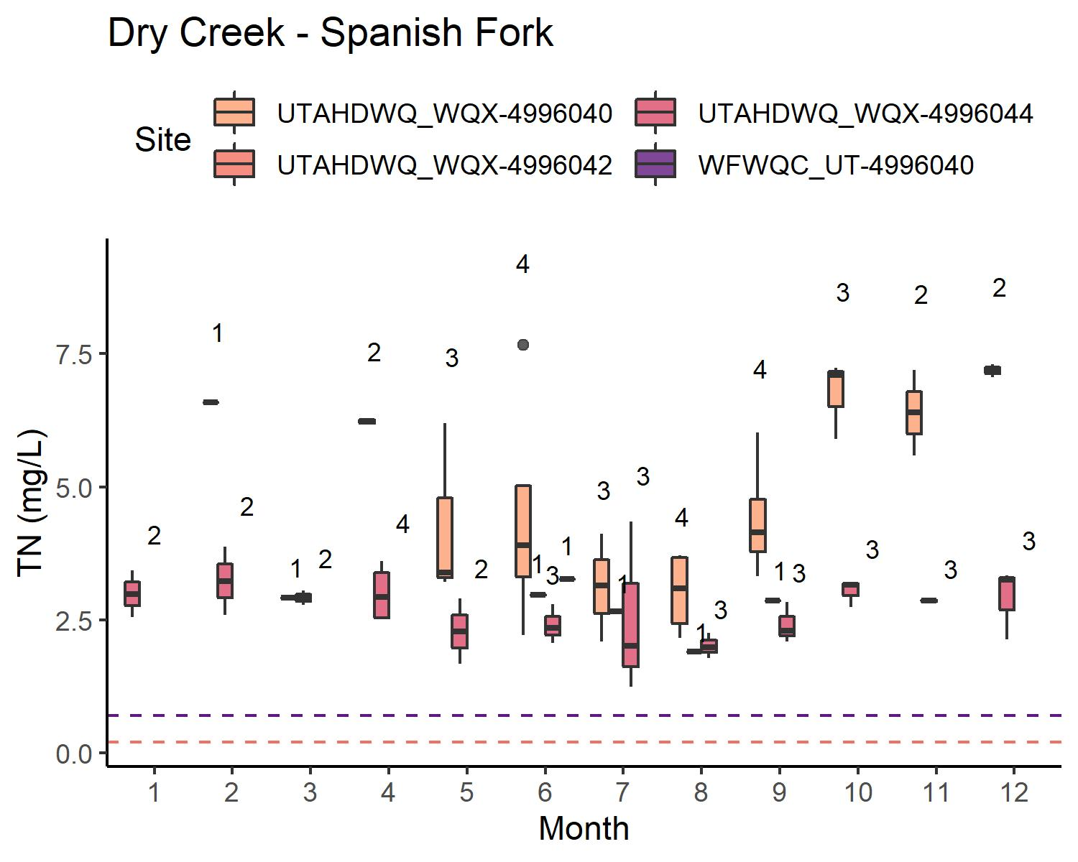
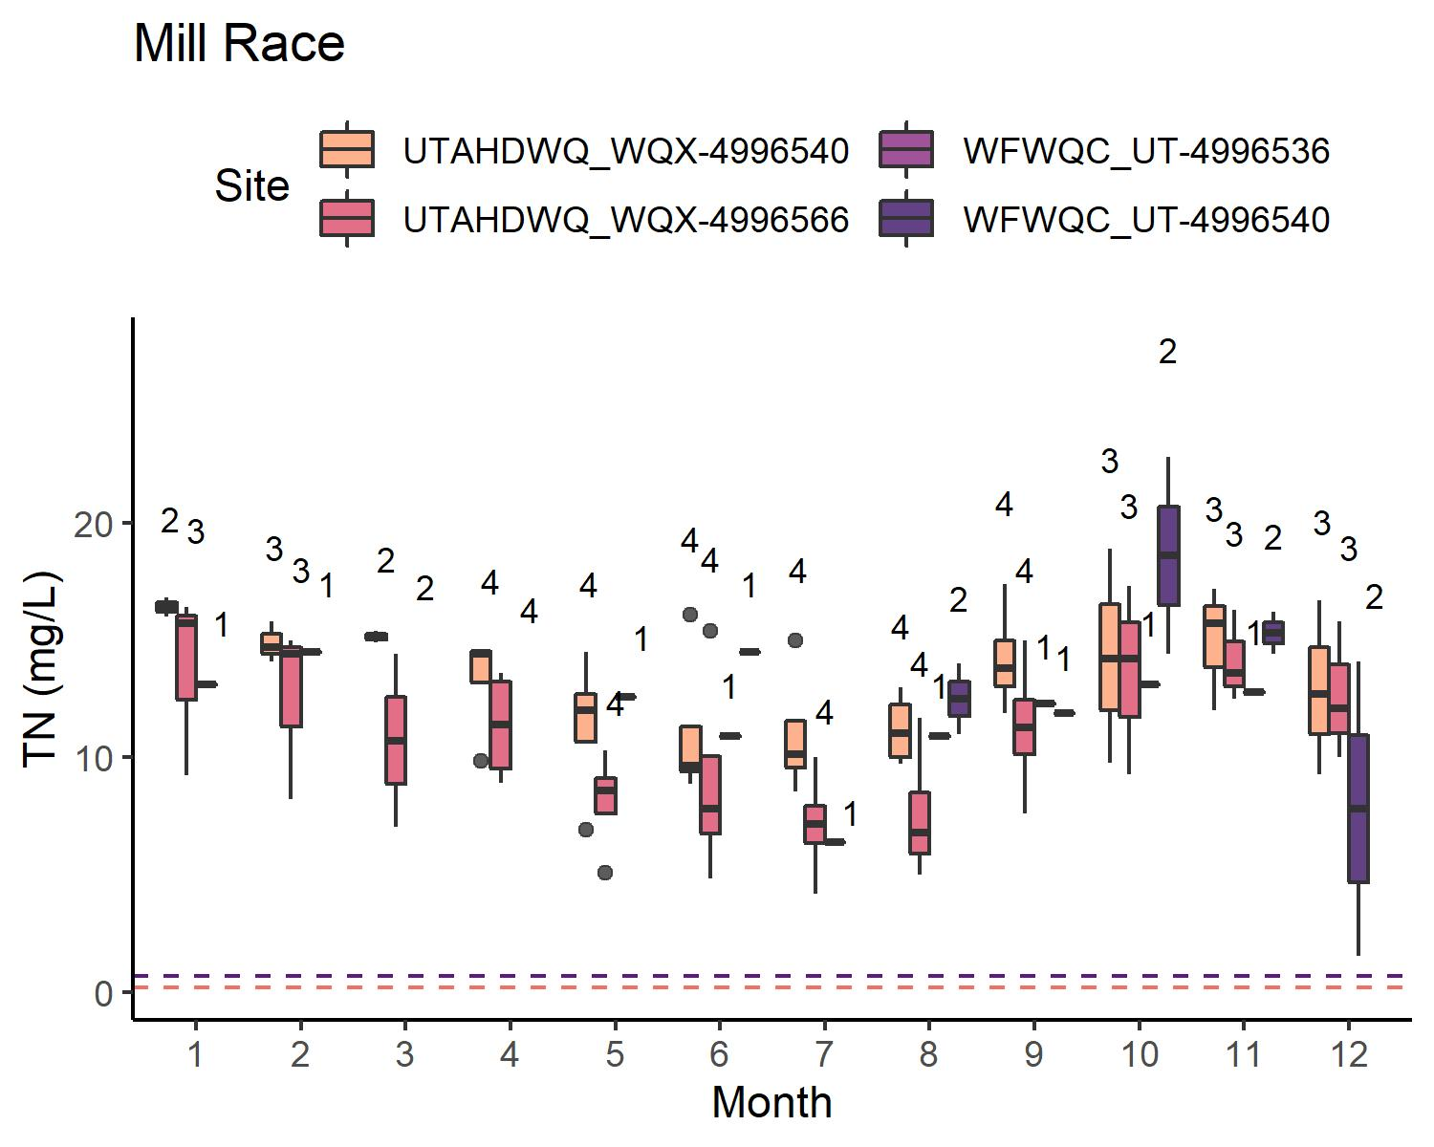
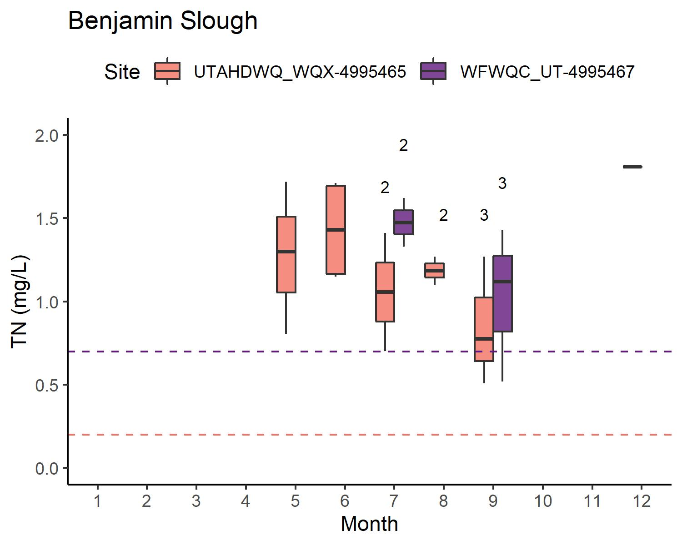
TN: WATERSHEDS W/ WWTP
Some sites are underwater sometimes → limited data for:
Powell Slough Major
Benjamin Slough
Data more limited for WFWQC sites than for UDWQ sites
Generally, concentrations are variable but comparable

Slide 13
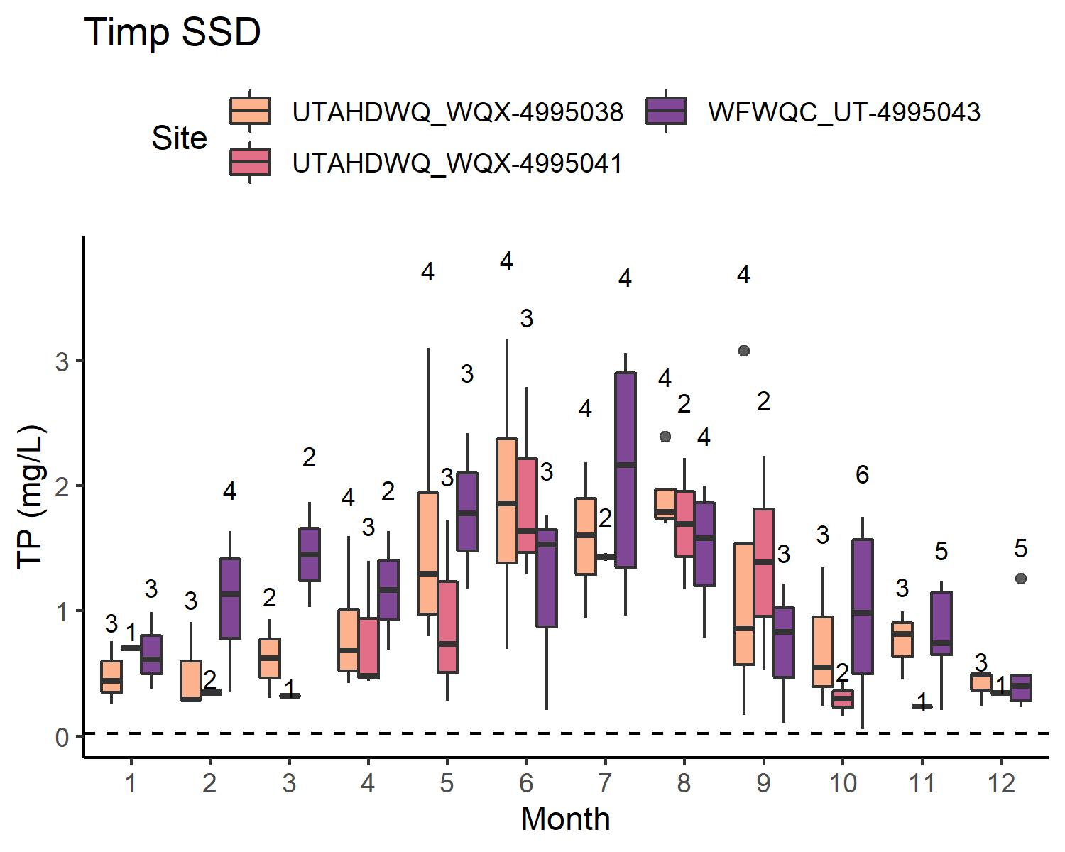
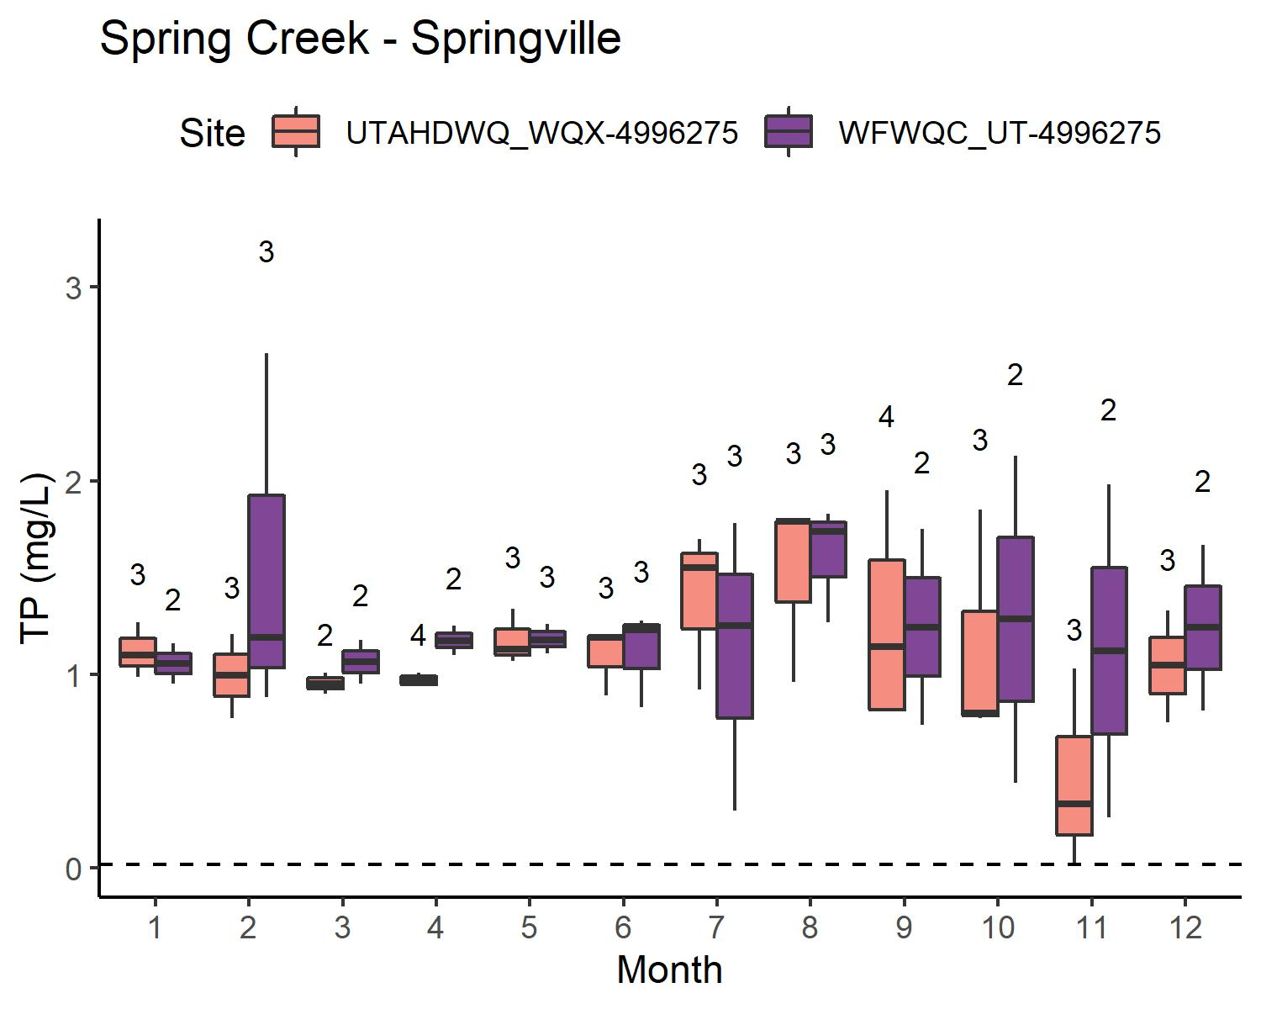
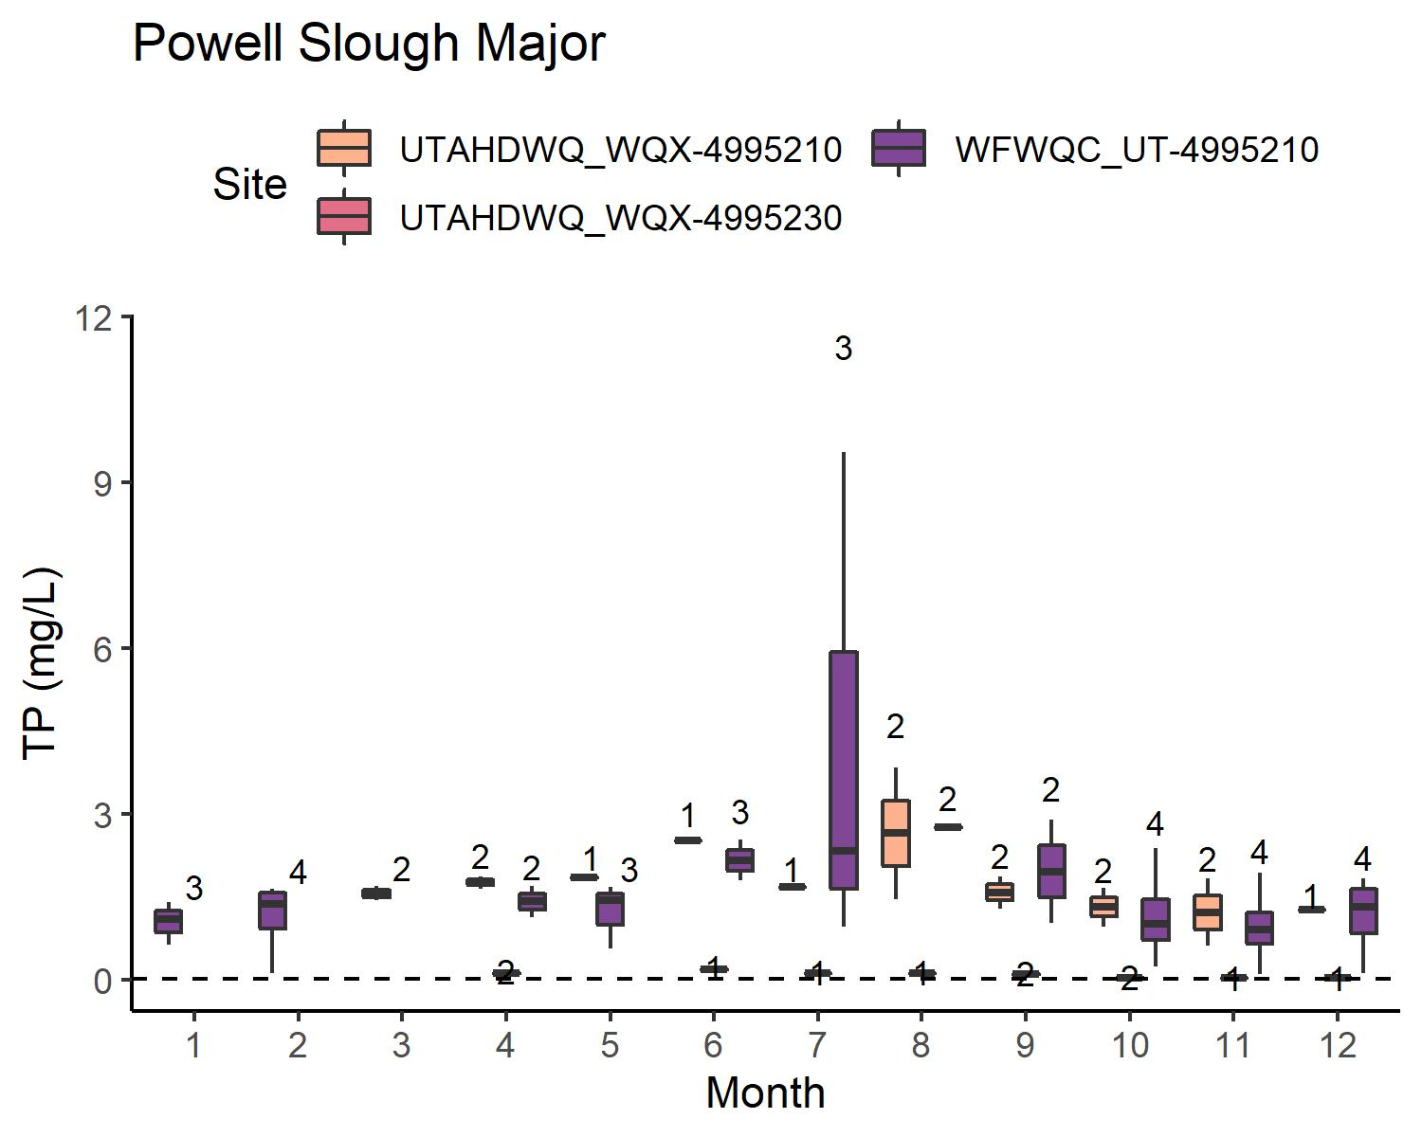
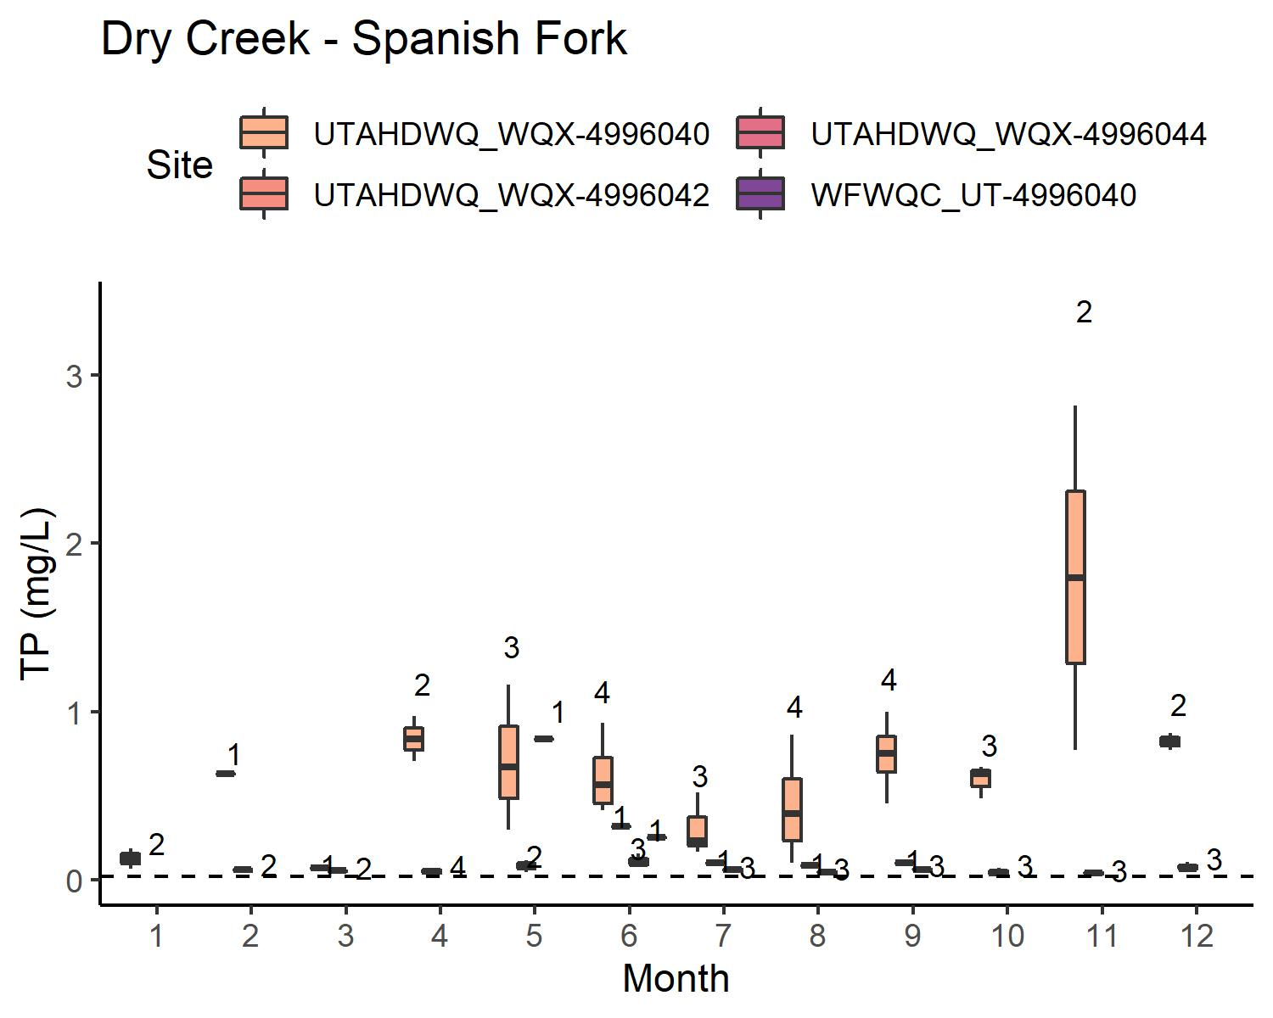
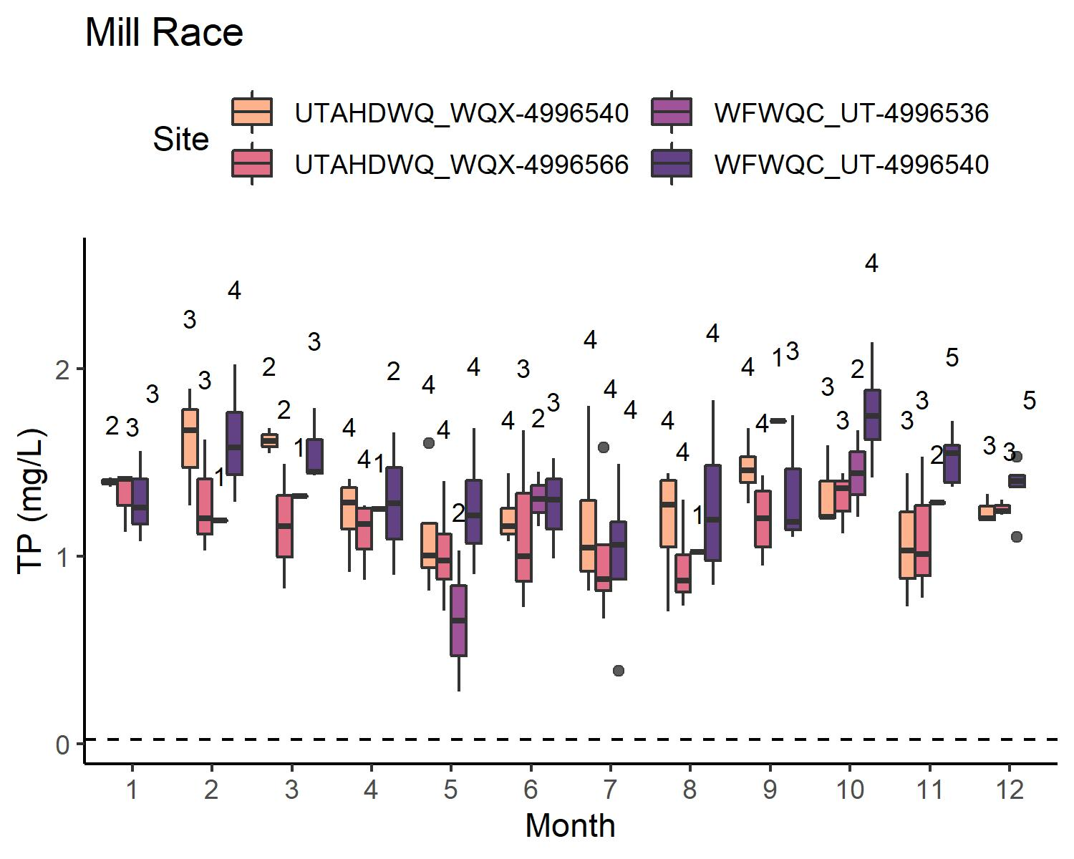
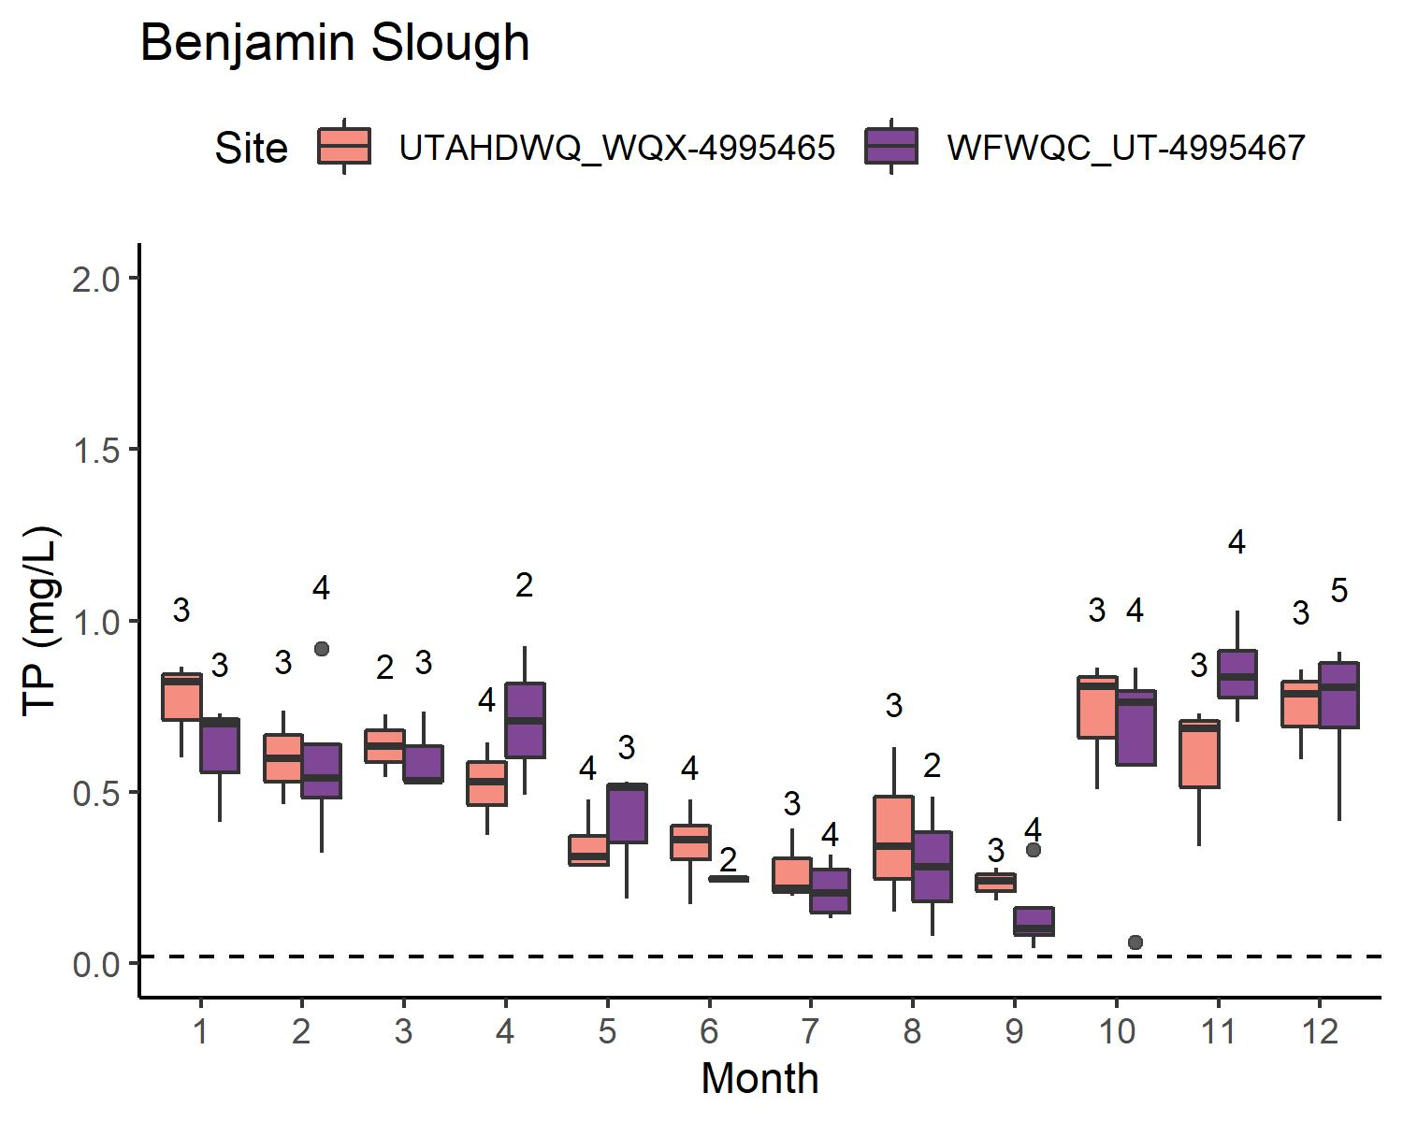
TP: WATERSHEDS W/ WWTP
Some sites are underwater sometimes → limited data for:
Powell Slough Major
Benjamin Slough
Data more limited for WFWQC sites than for UDWQ sites
Generally, concentrations are variable but comparable

Slide 14
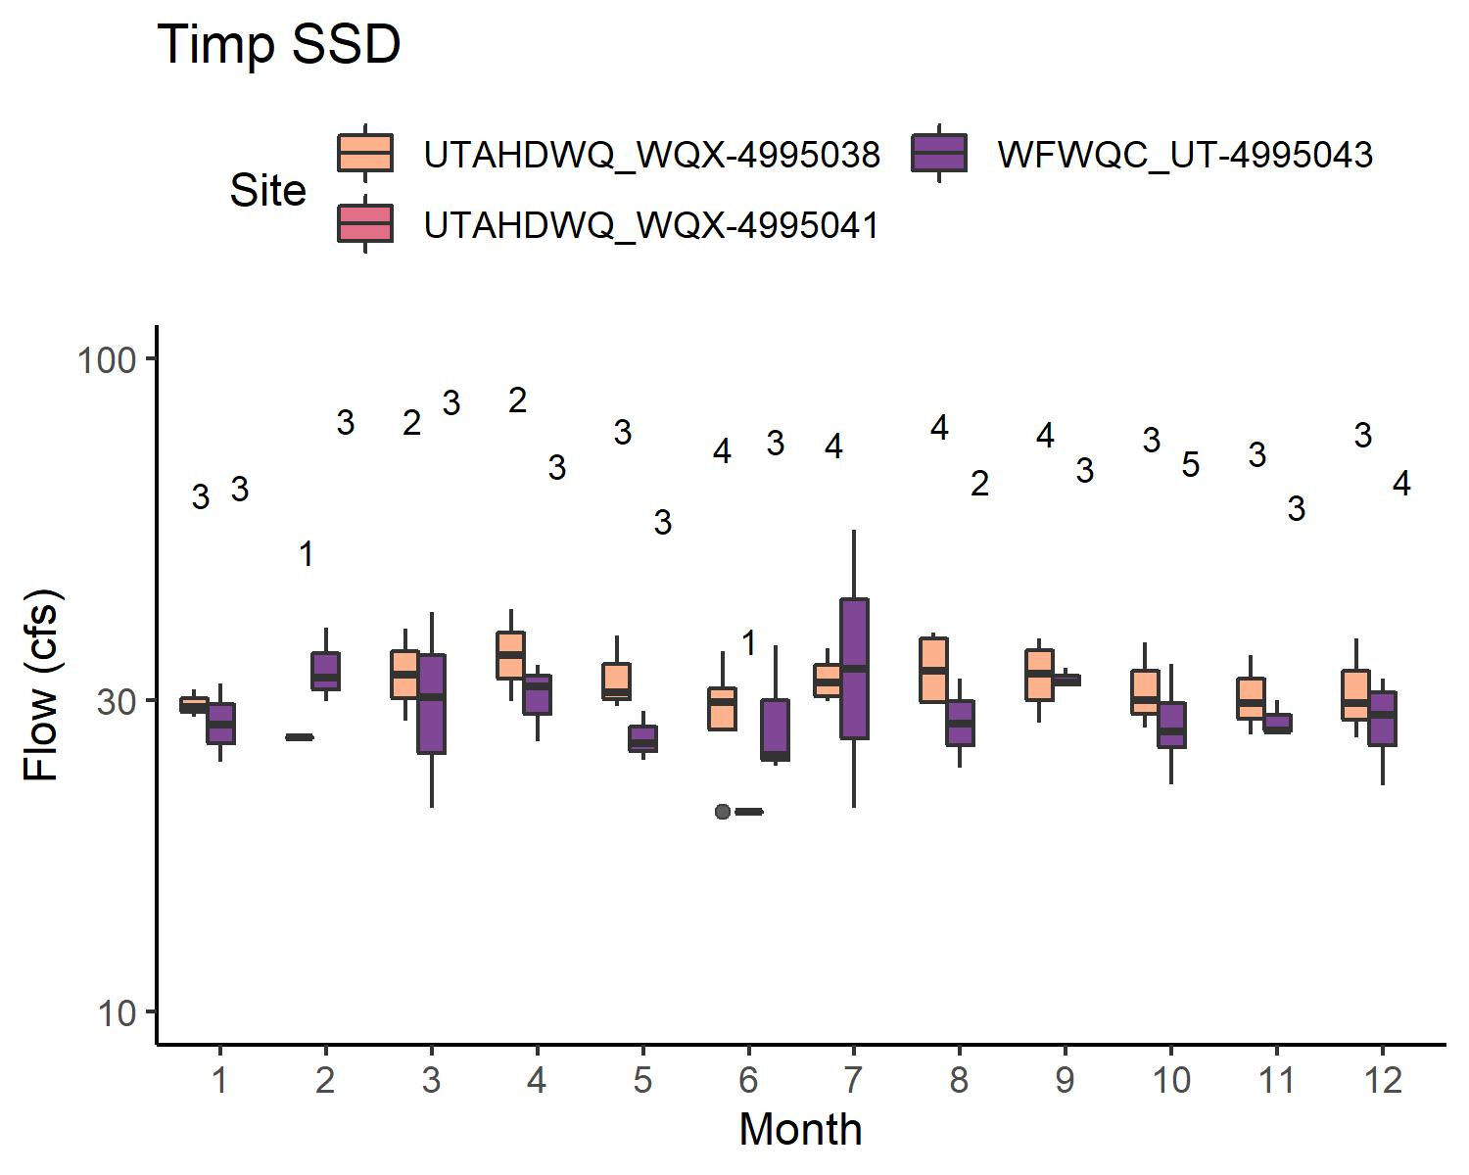
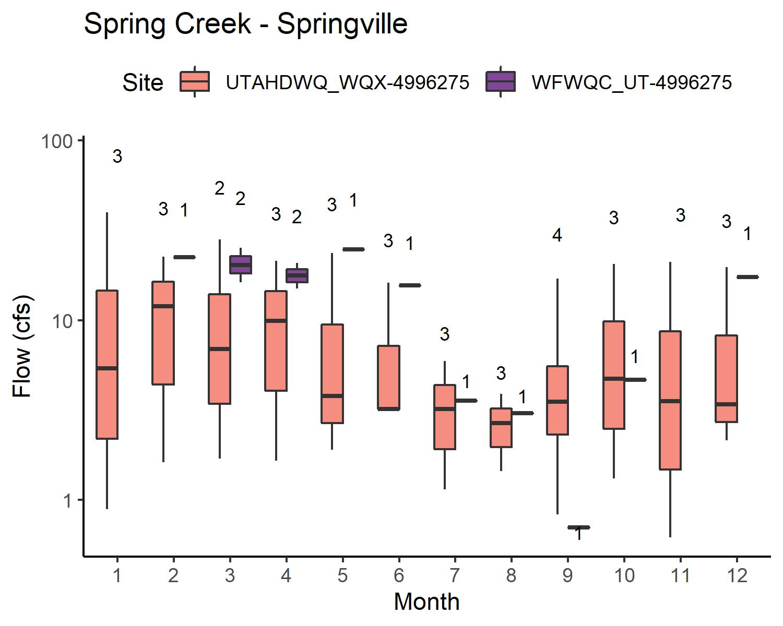
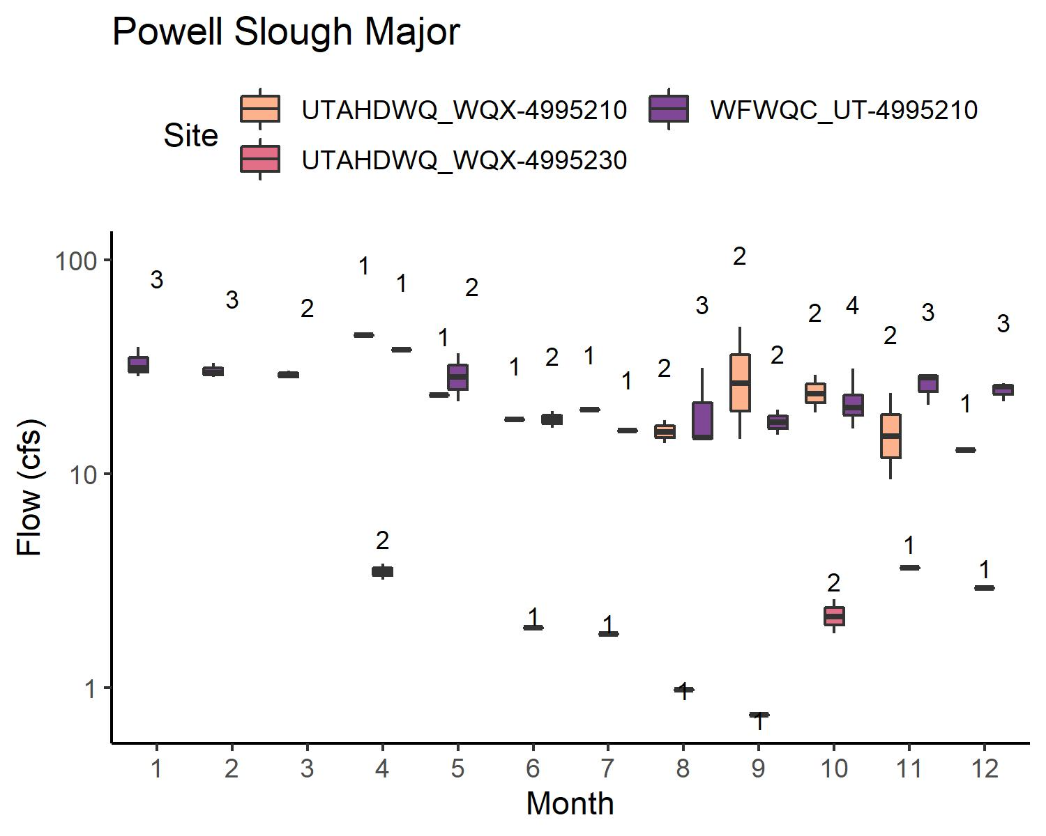
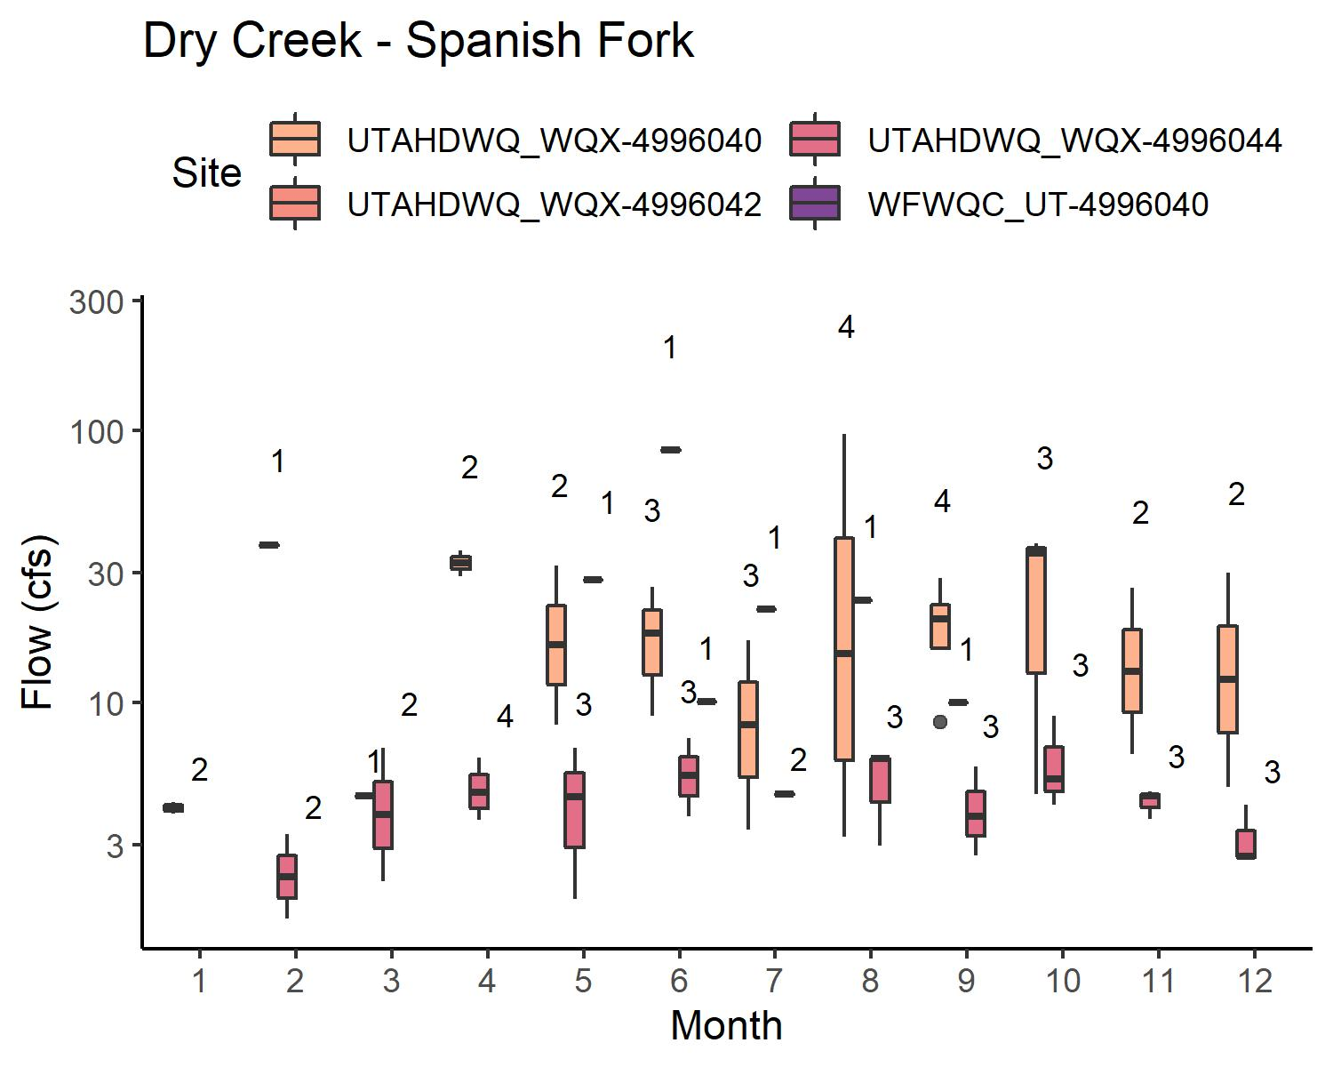
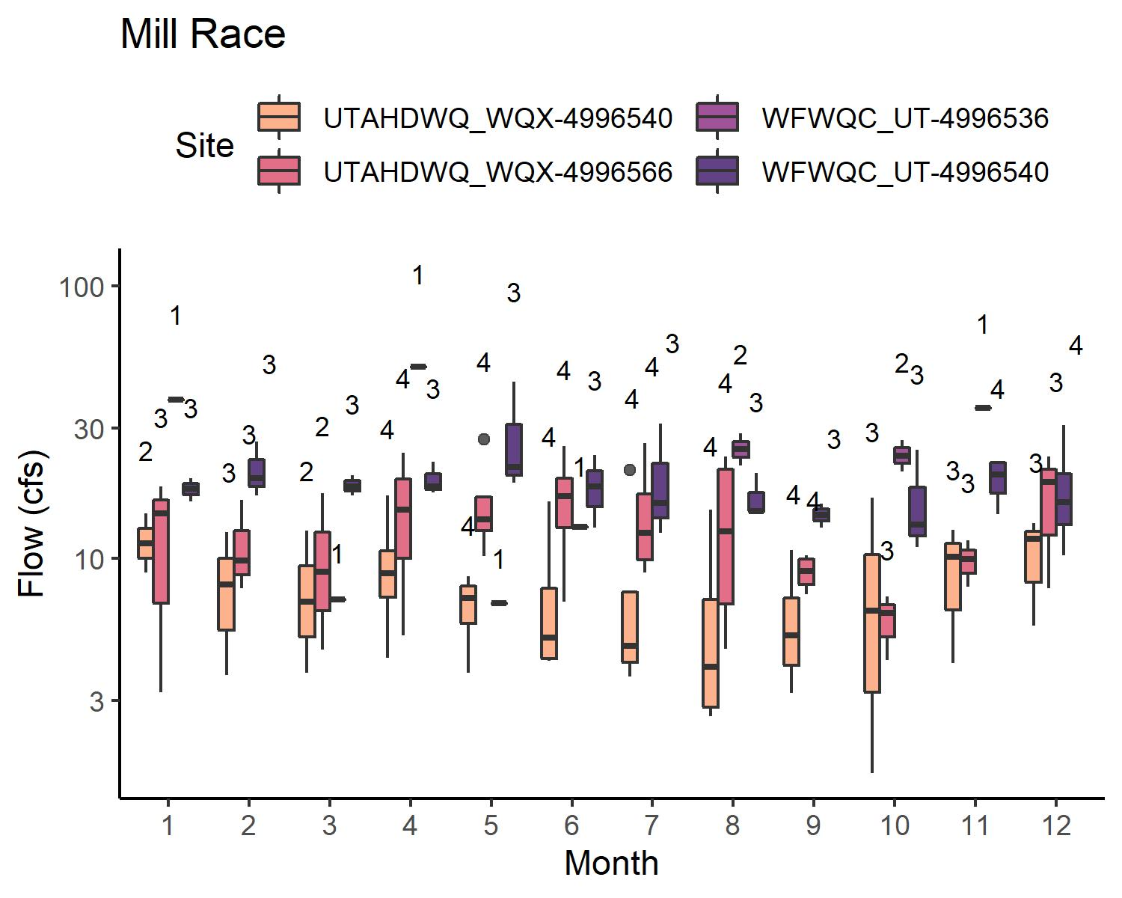
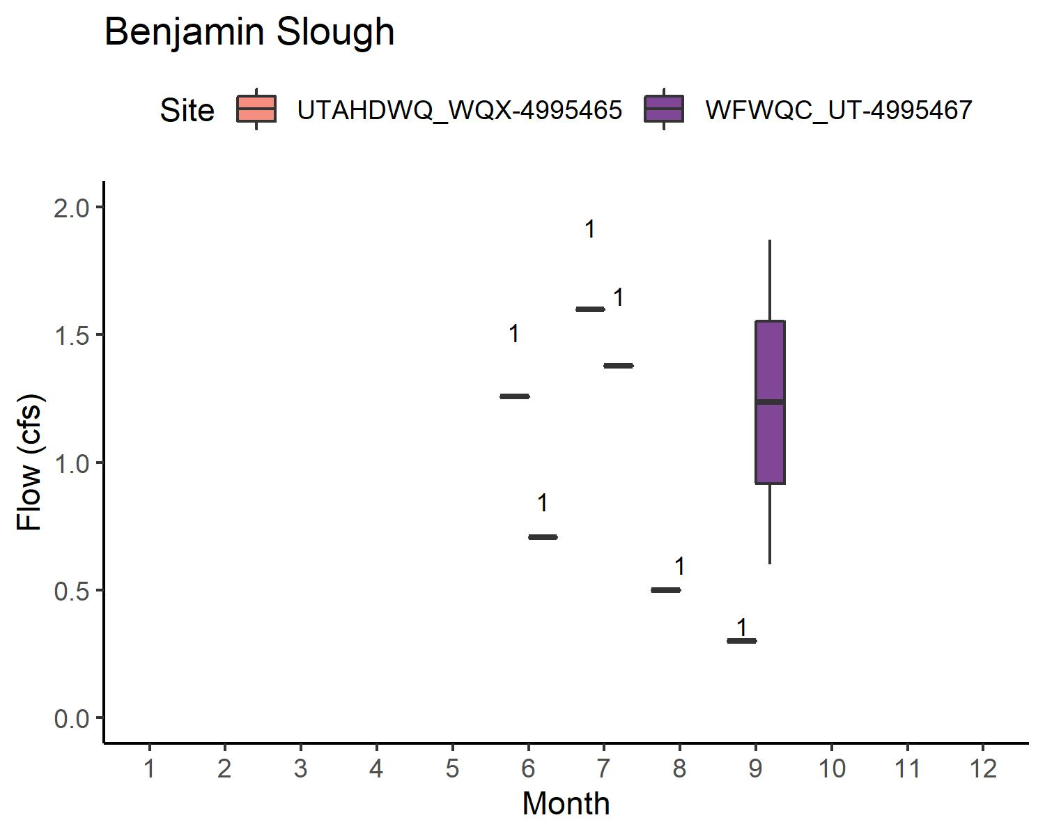
FLOW: WATERSHEDS W/ WWTP
Some sites are underwater sometimes → limited data for:
Powell Slough Major
Benjamin Slough
Data more limited for WFWQC sites than for UDWQ sites
Generally, flow is variable but comparable

Slide 15
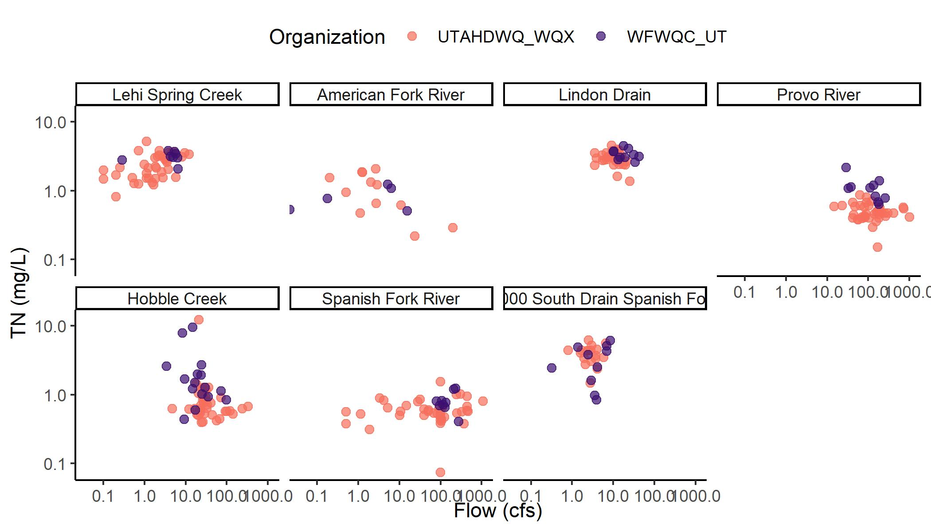
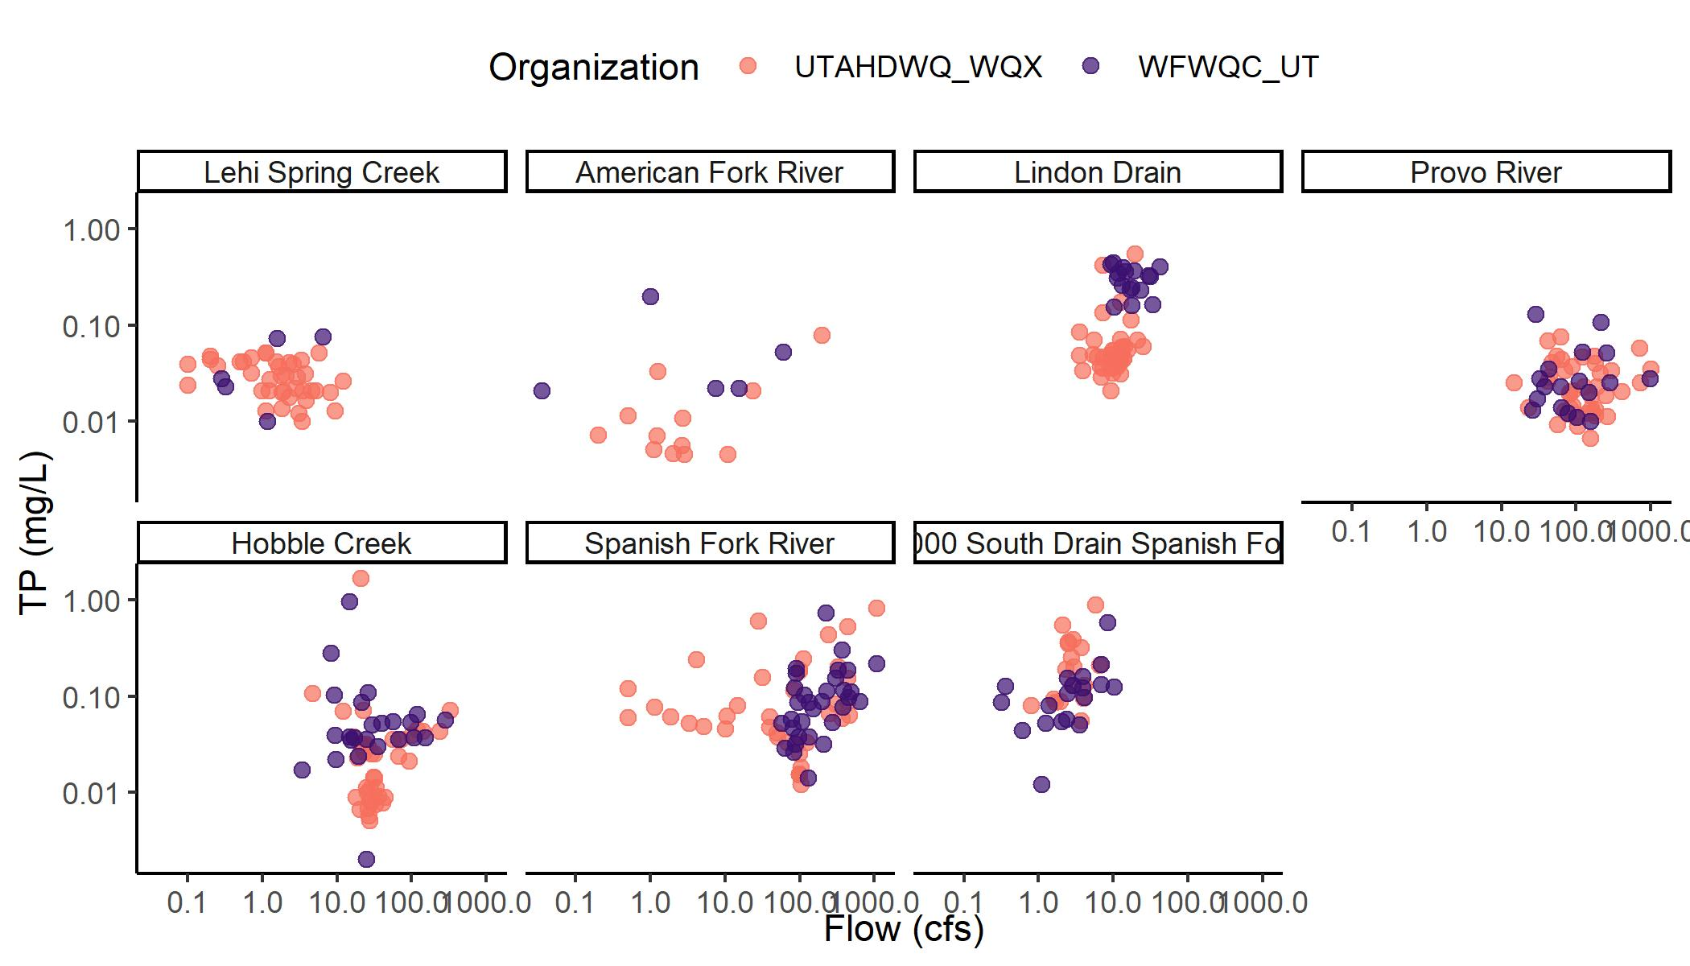
C-Q RELATIONSHIPS WATERSHEDS W/O WWTP
Watersheds w/ similar distributions
Hobble Creek
4000 South Drain Spanish Fork
Provo River (Q, TP)
Watersheds w/ truncated distribution for WFWQC
Lindon Drain
Spanish Fork River
Watersheds w/ few WFWQC samples
Lehi Spring Creek
American Fork River
Provo River (TN)
Spanish Fork River (TN)

Slide 16
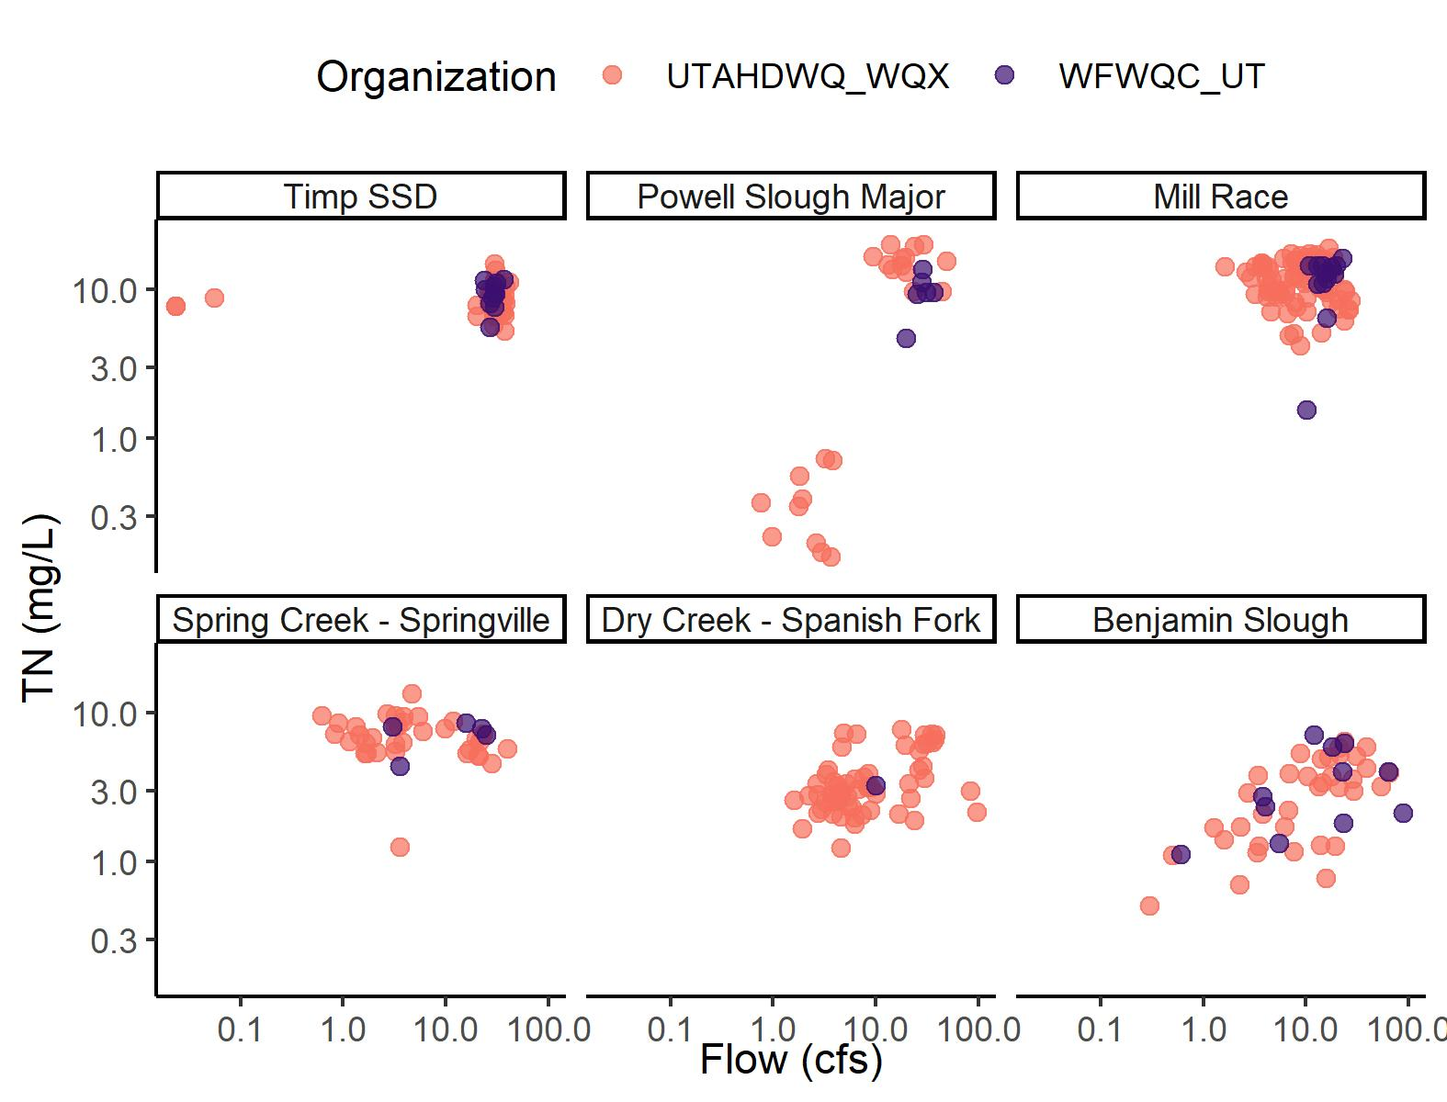
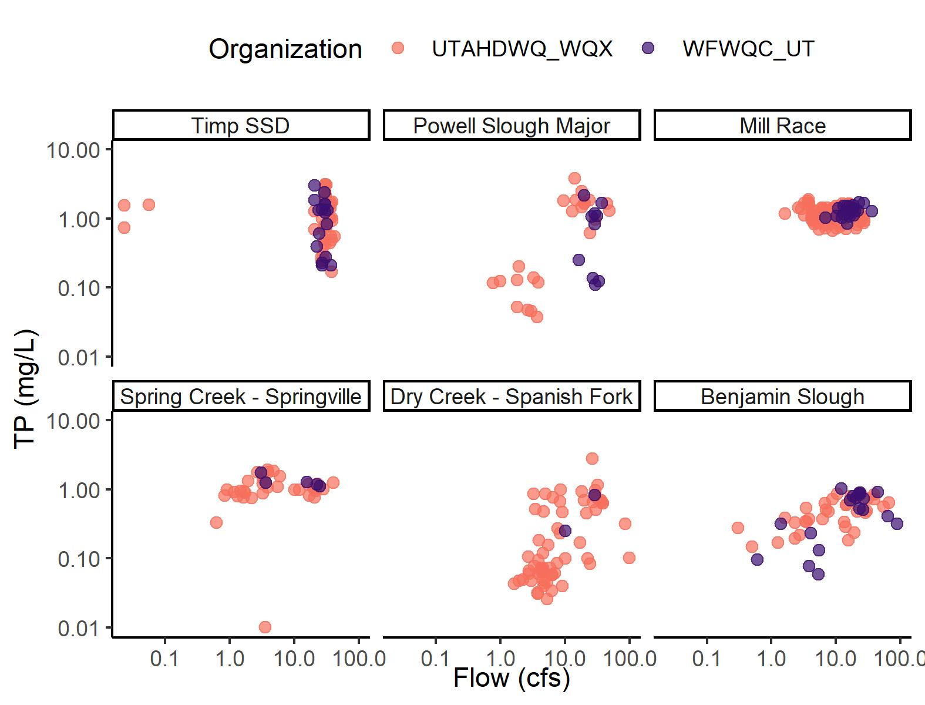
C-Q RELATIONSHIPS WATERSHEDS W/ WWTP
Watersheds w/ similar distributions
Timp SSD
Benjamin Slough
Watersheds w/ truncated distribution for WFWQC
Powell Slough Major
Watersheds w/ few WFWQC samples
Powell Slough Major
Mill Race
Spring Creek – Springville
Dry Creek – Spanish Fork

Slide 17
TAKEAWAYS: COMPARISON OF UDWQ AND WFWQC MONITORING
Reporting limit is an issue for WFWQC samples in watersheds w/o WWTP
UDWQ sampling is more comprehensive than WFWQC for some watersheds
Concentrations and flows are often, but not always equivalent → discrepancies could be a function of bias or limited sampling
SAP and/or QAPP not available for WFWQC flow estimates
Recommend moving forward with UDWQ data. Choices:
Incorporate WFWQC data and use measurements regardless of entity
Exclude WFWQC data

Slide 18
ADDITIONAL QUESTIONS
What to do for months missing data? (≠ months w/ zero flow)
→ suggest inserting load from nearest month (linear or piecewise constant interpolation)

Slide 19
UPPERCASE TITLES
Lowercase text

